Slide 1
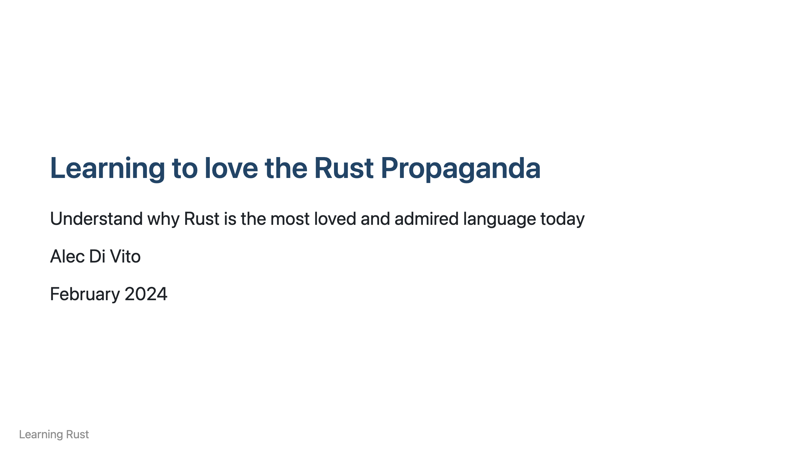

Slide 2
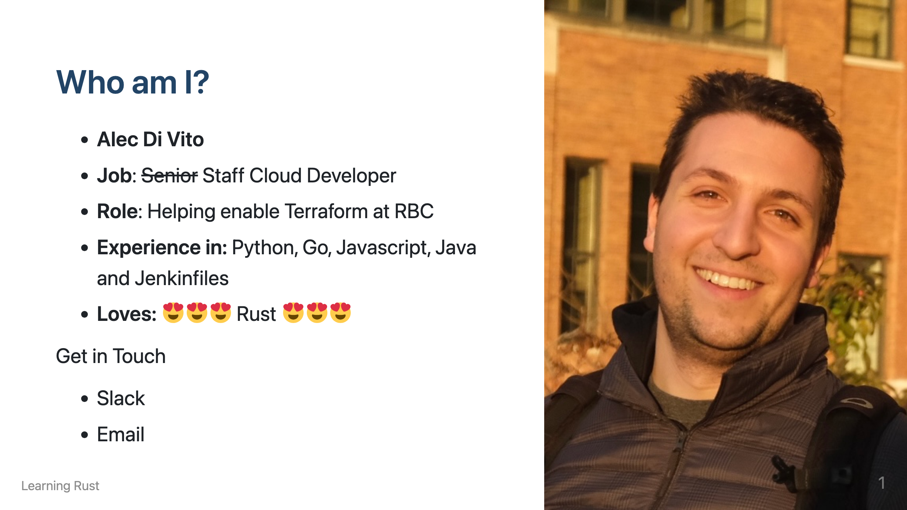

Slide 3
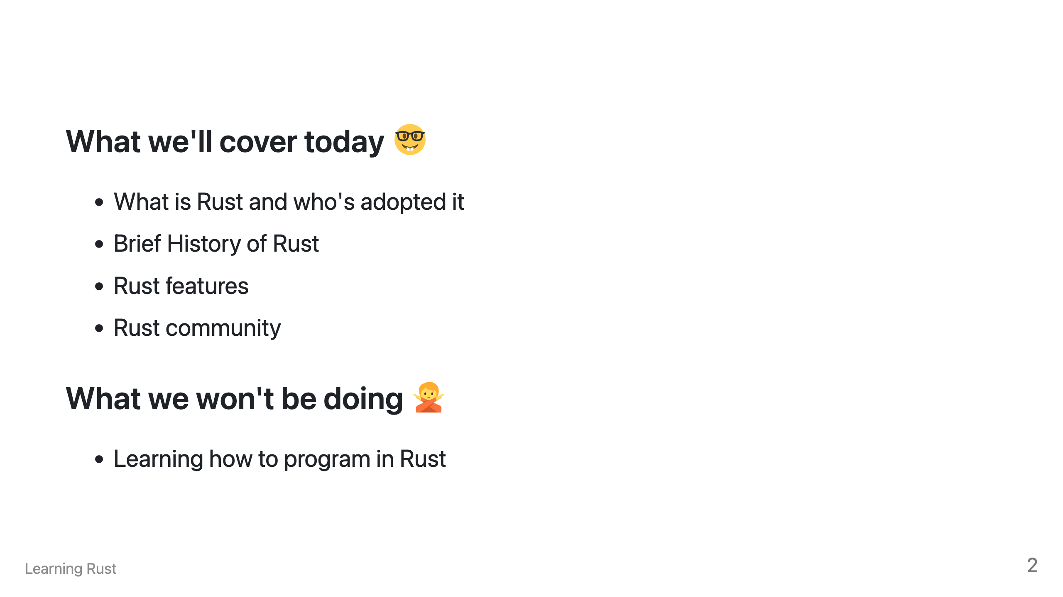

Slide 4
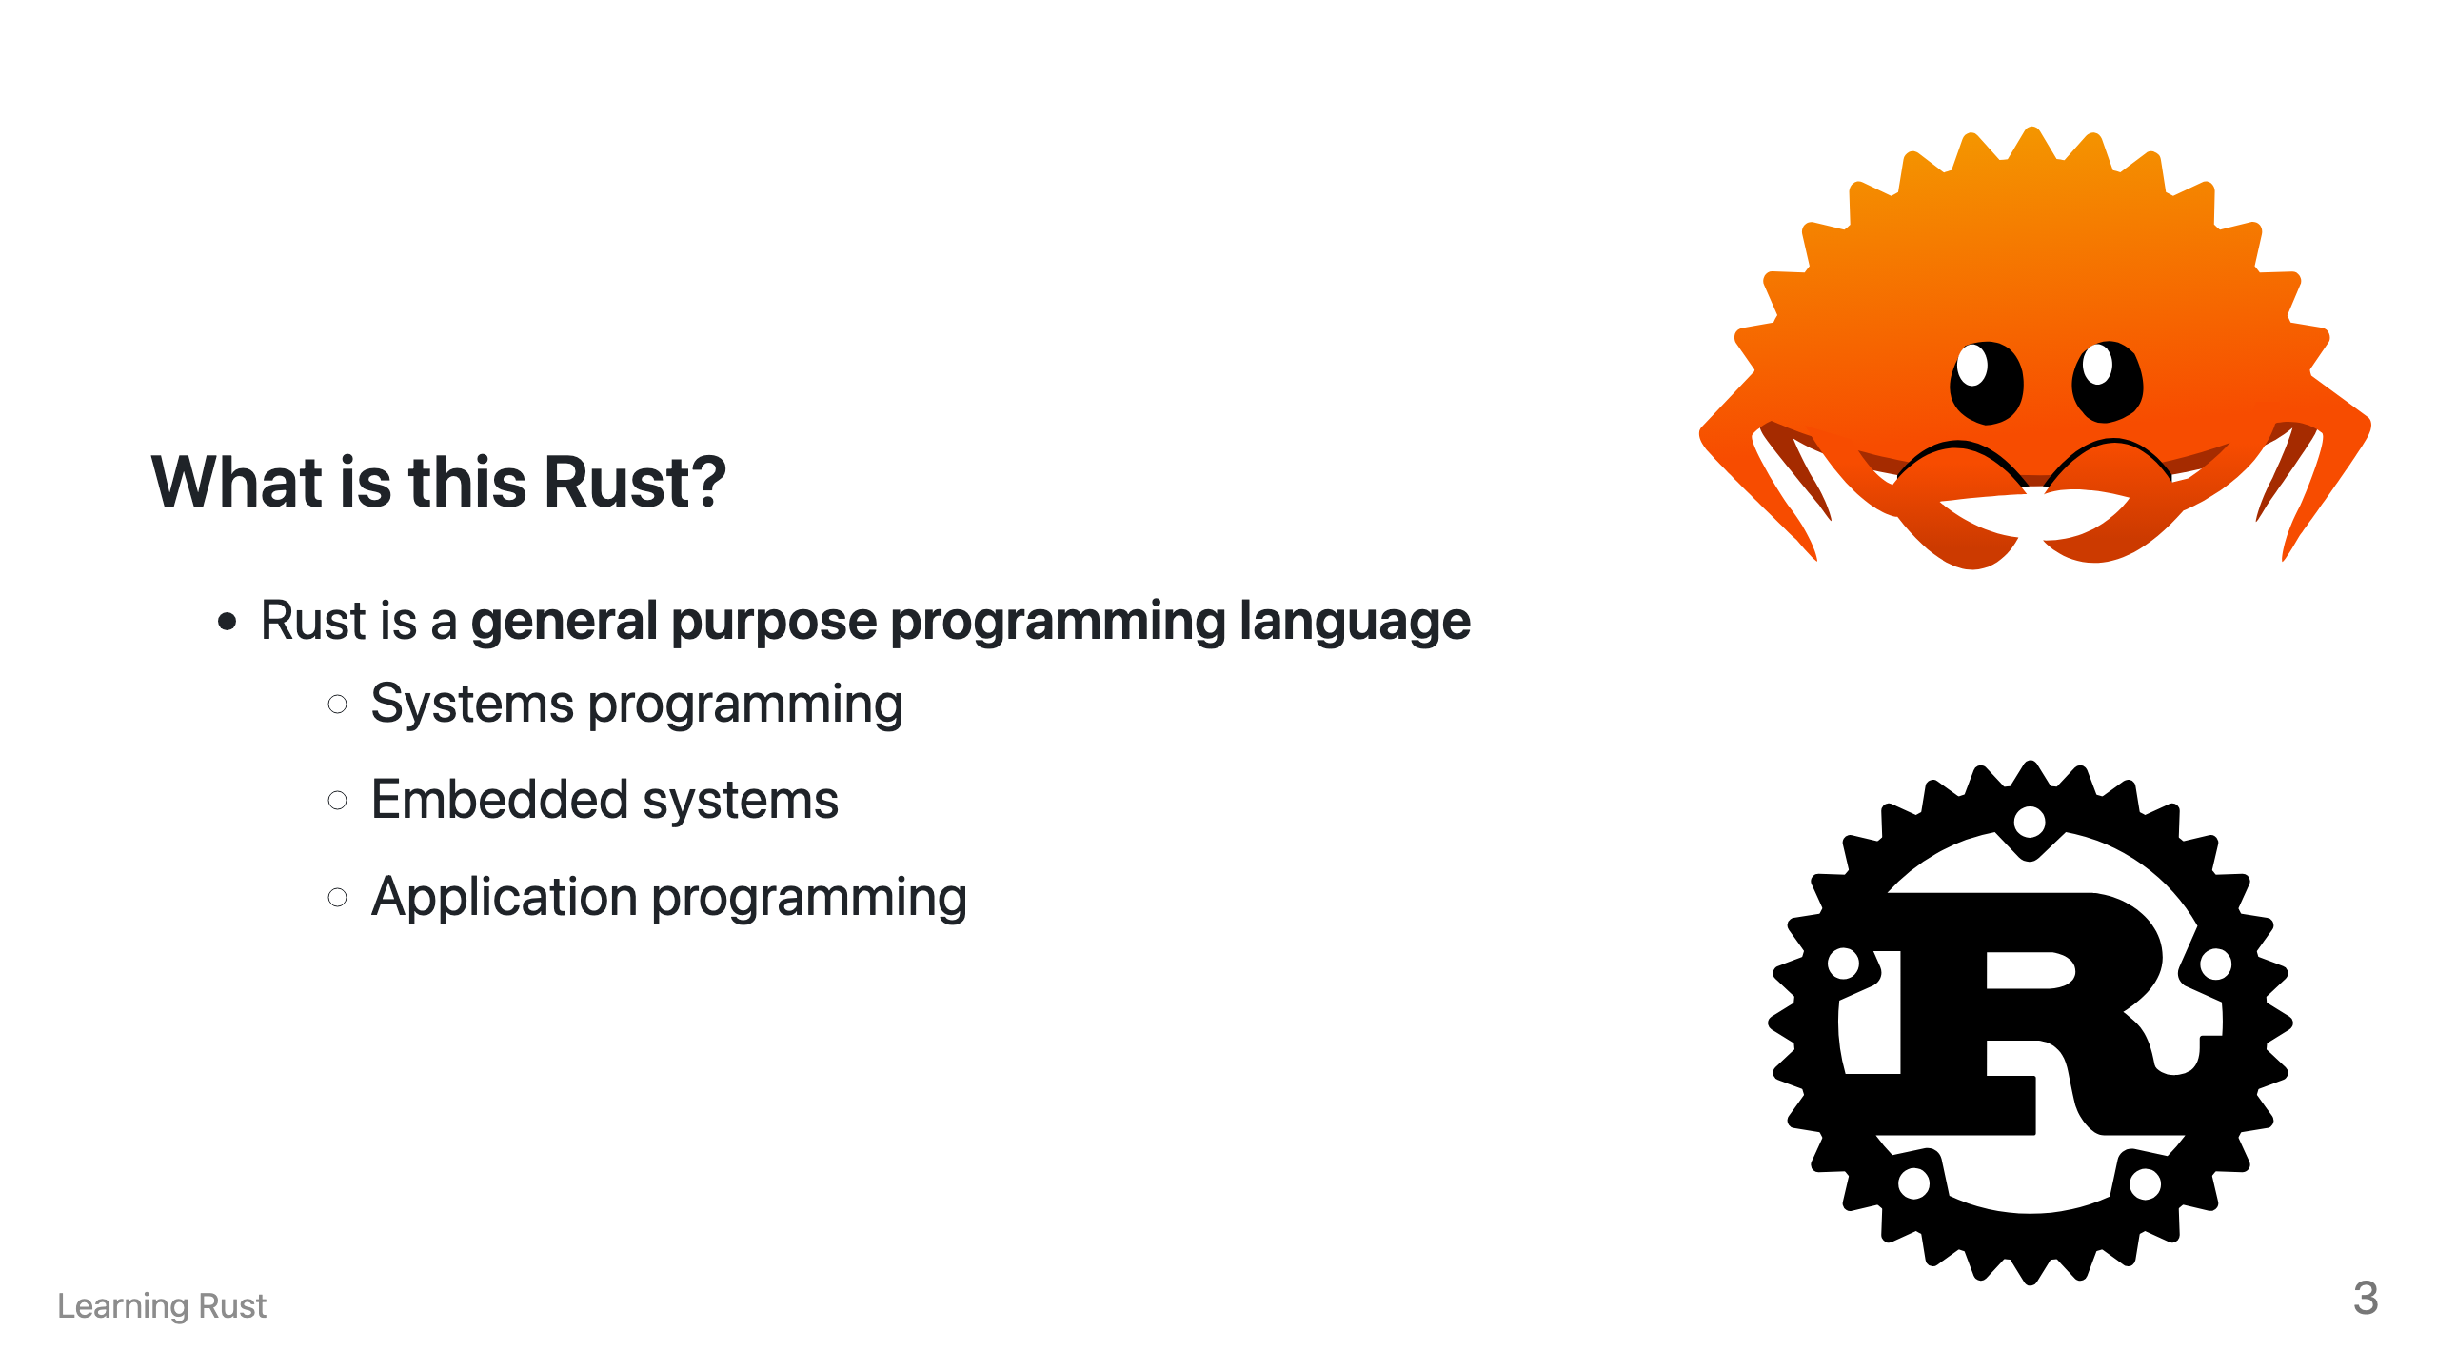

Slide 5
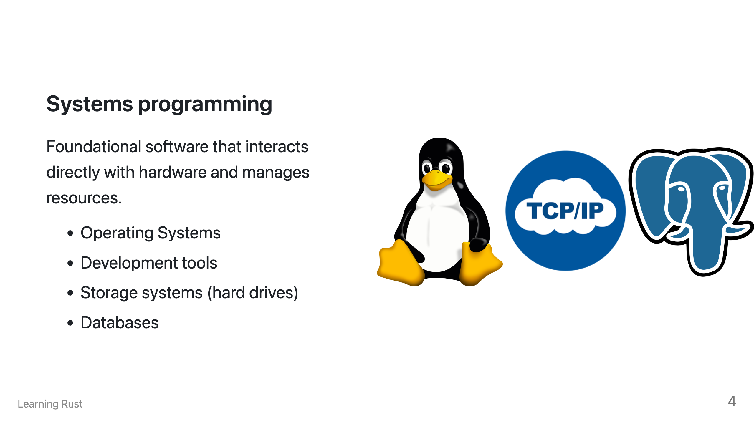

Slide 6
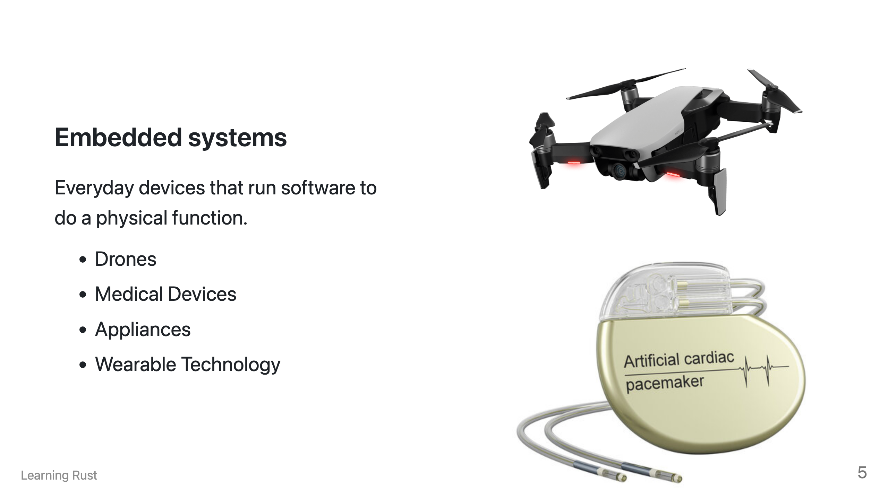

Slide 7
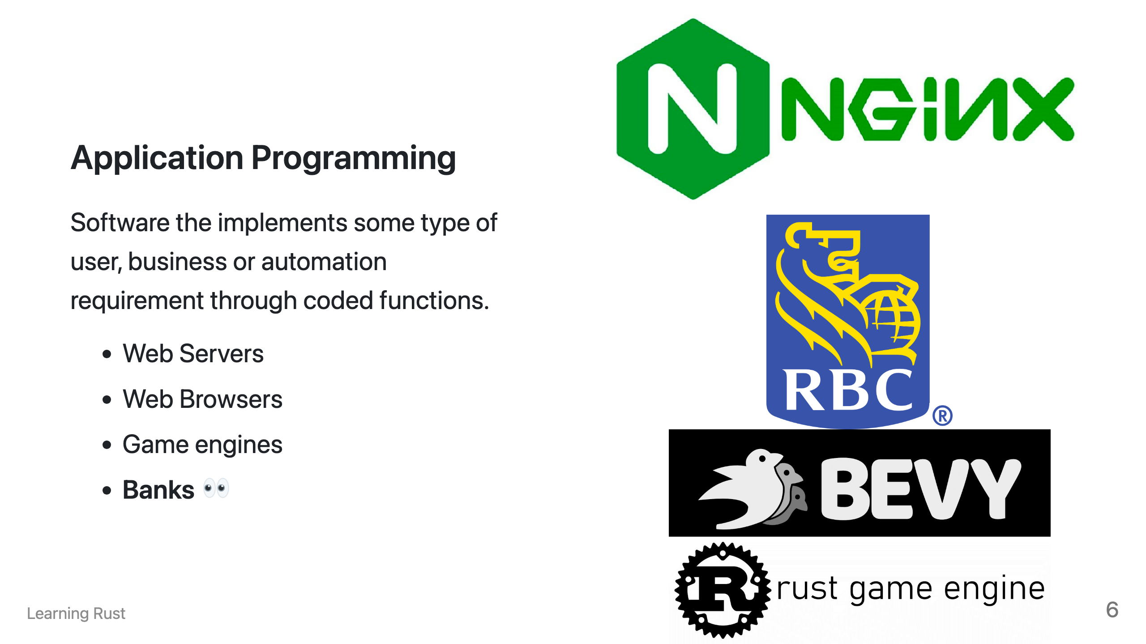

Slide 8
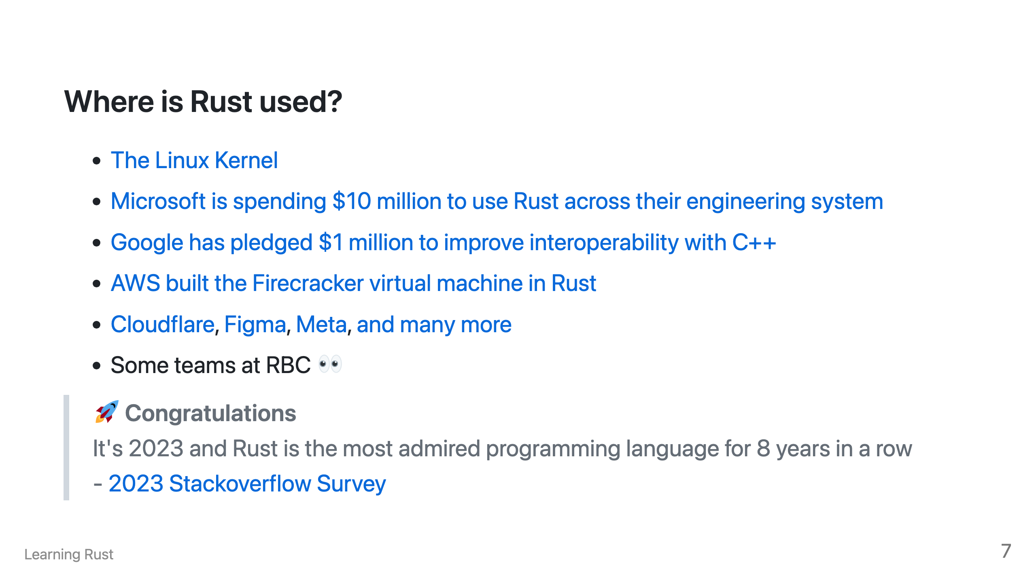

Slide 9
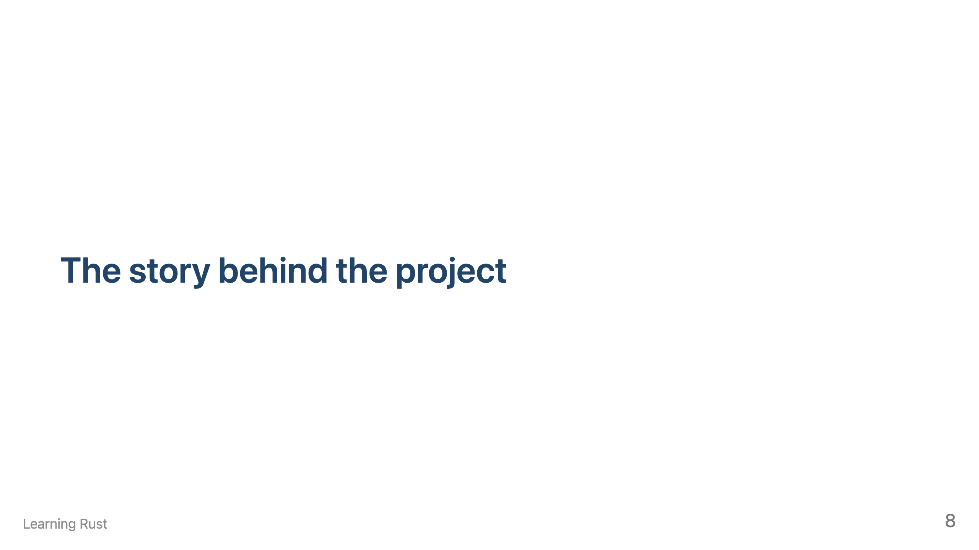

Slide 10
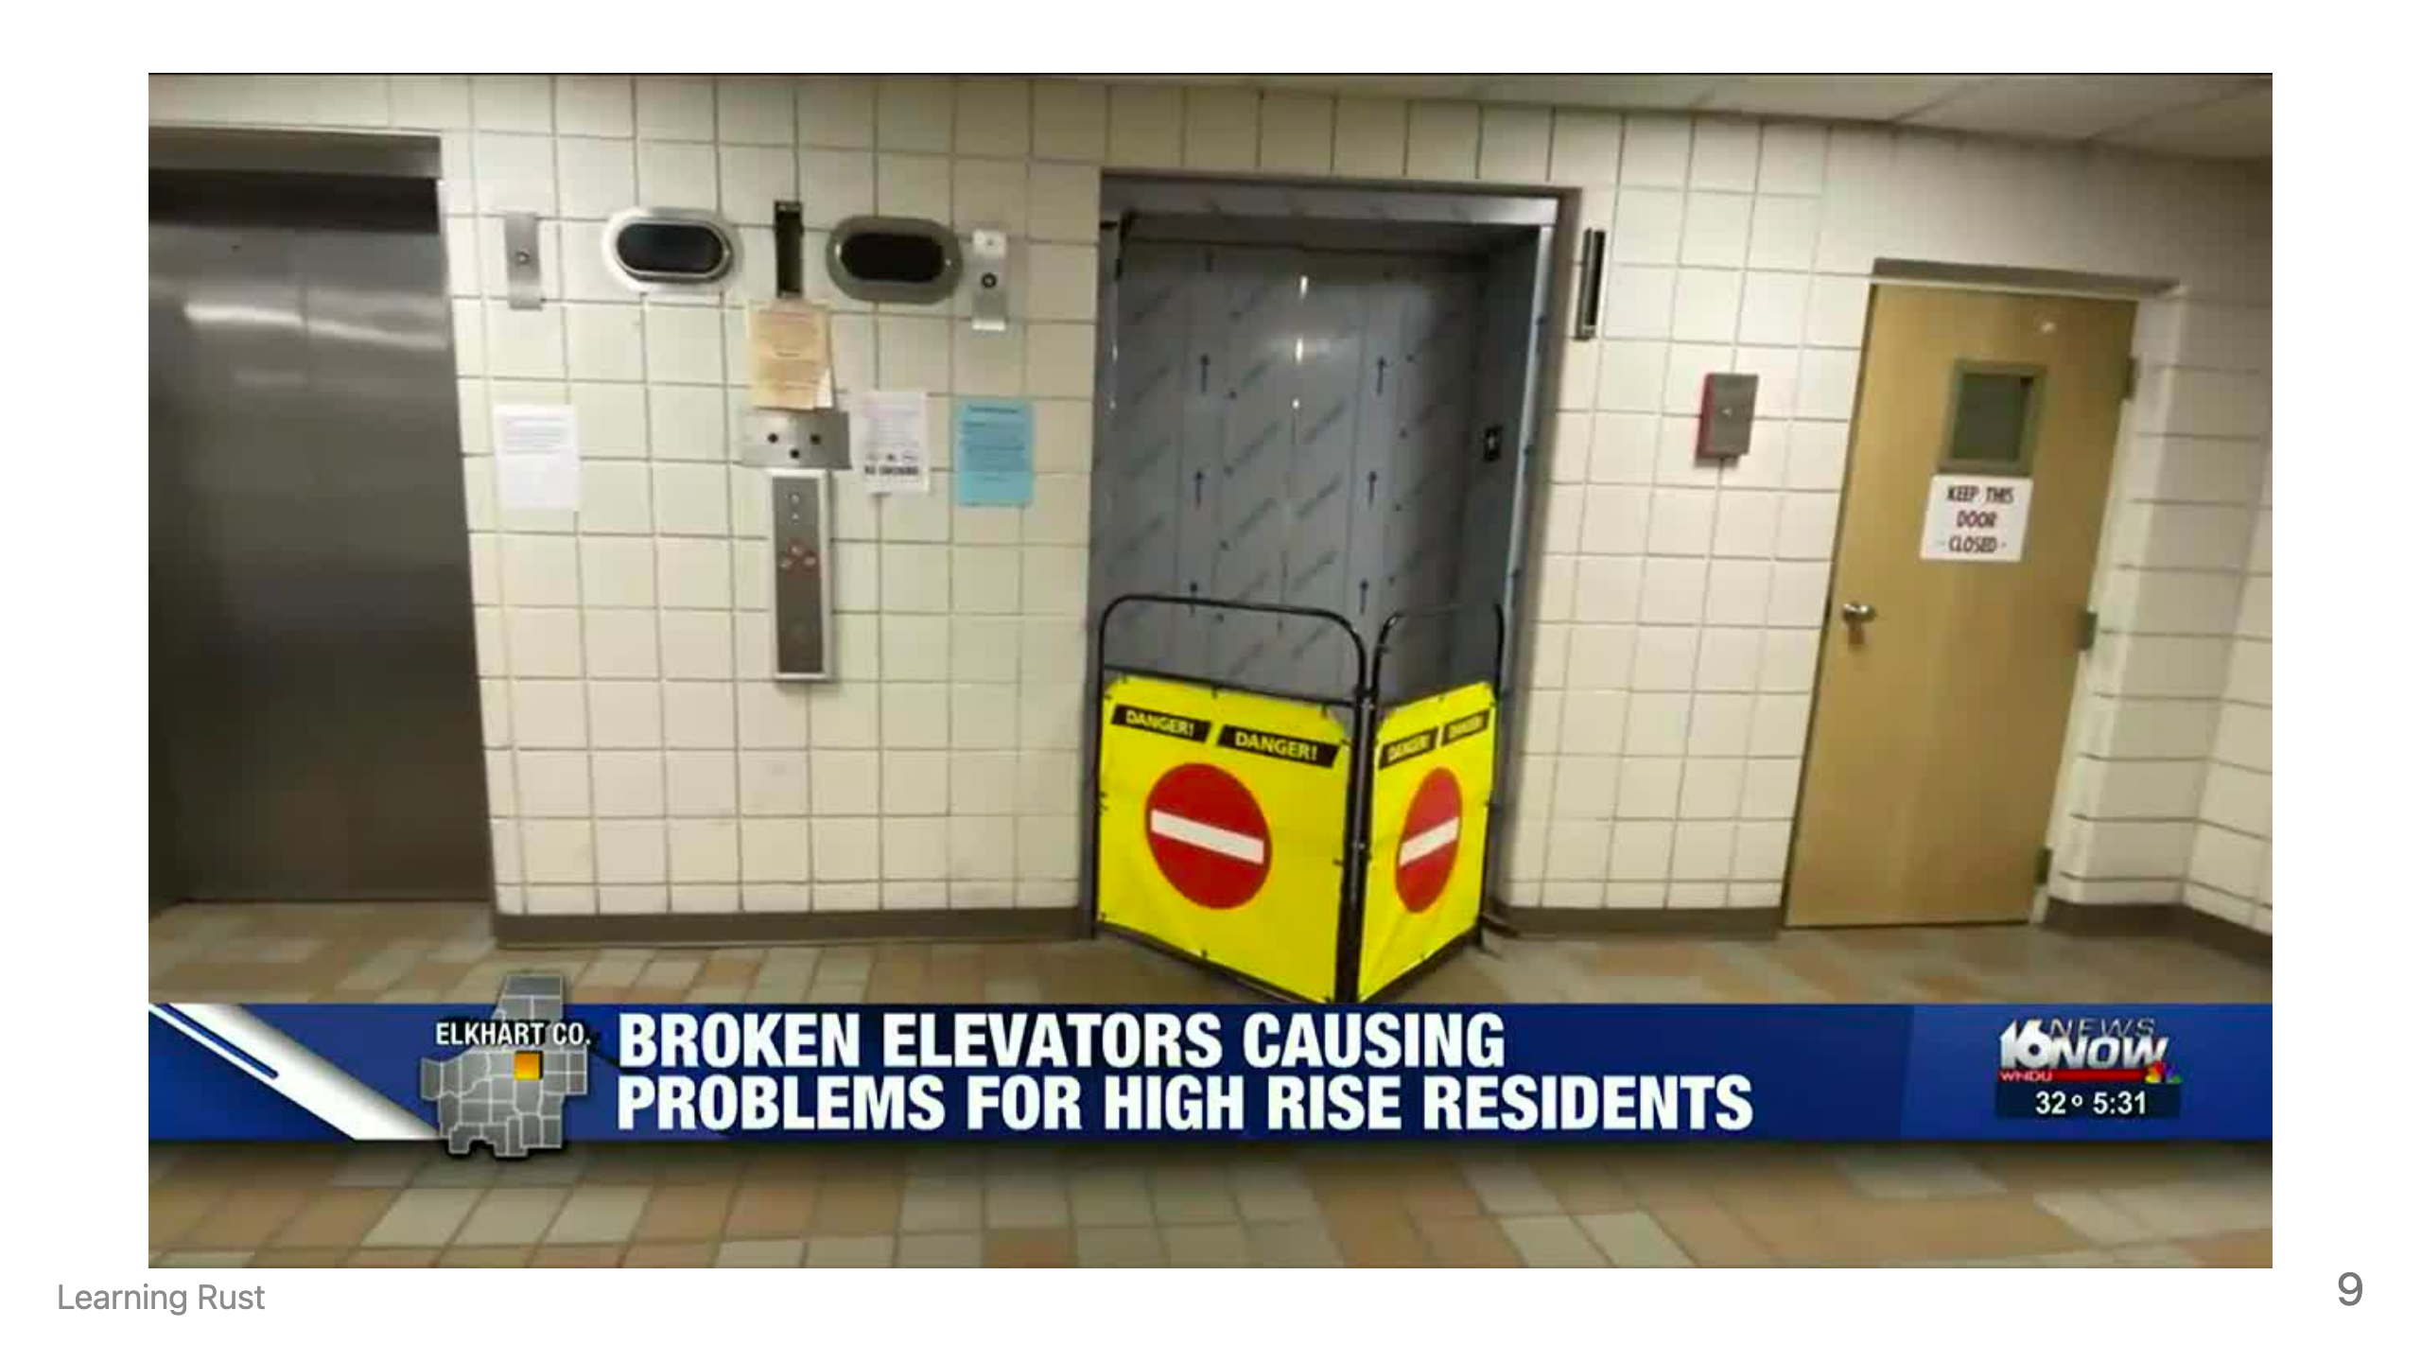
Notes:
- Started as a personal project in 2006 by Graydon Hoare - He was a 29 year old developer working at **Mozilla** - The elevator wasn't working again after work; Software had crashed - While walking up **21 floors** he thought about how software developers couldn't make an elevator work without crashing - Rust was born, **"over-engineered for survival"**

Slide 11
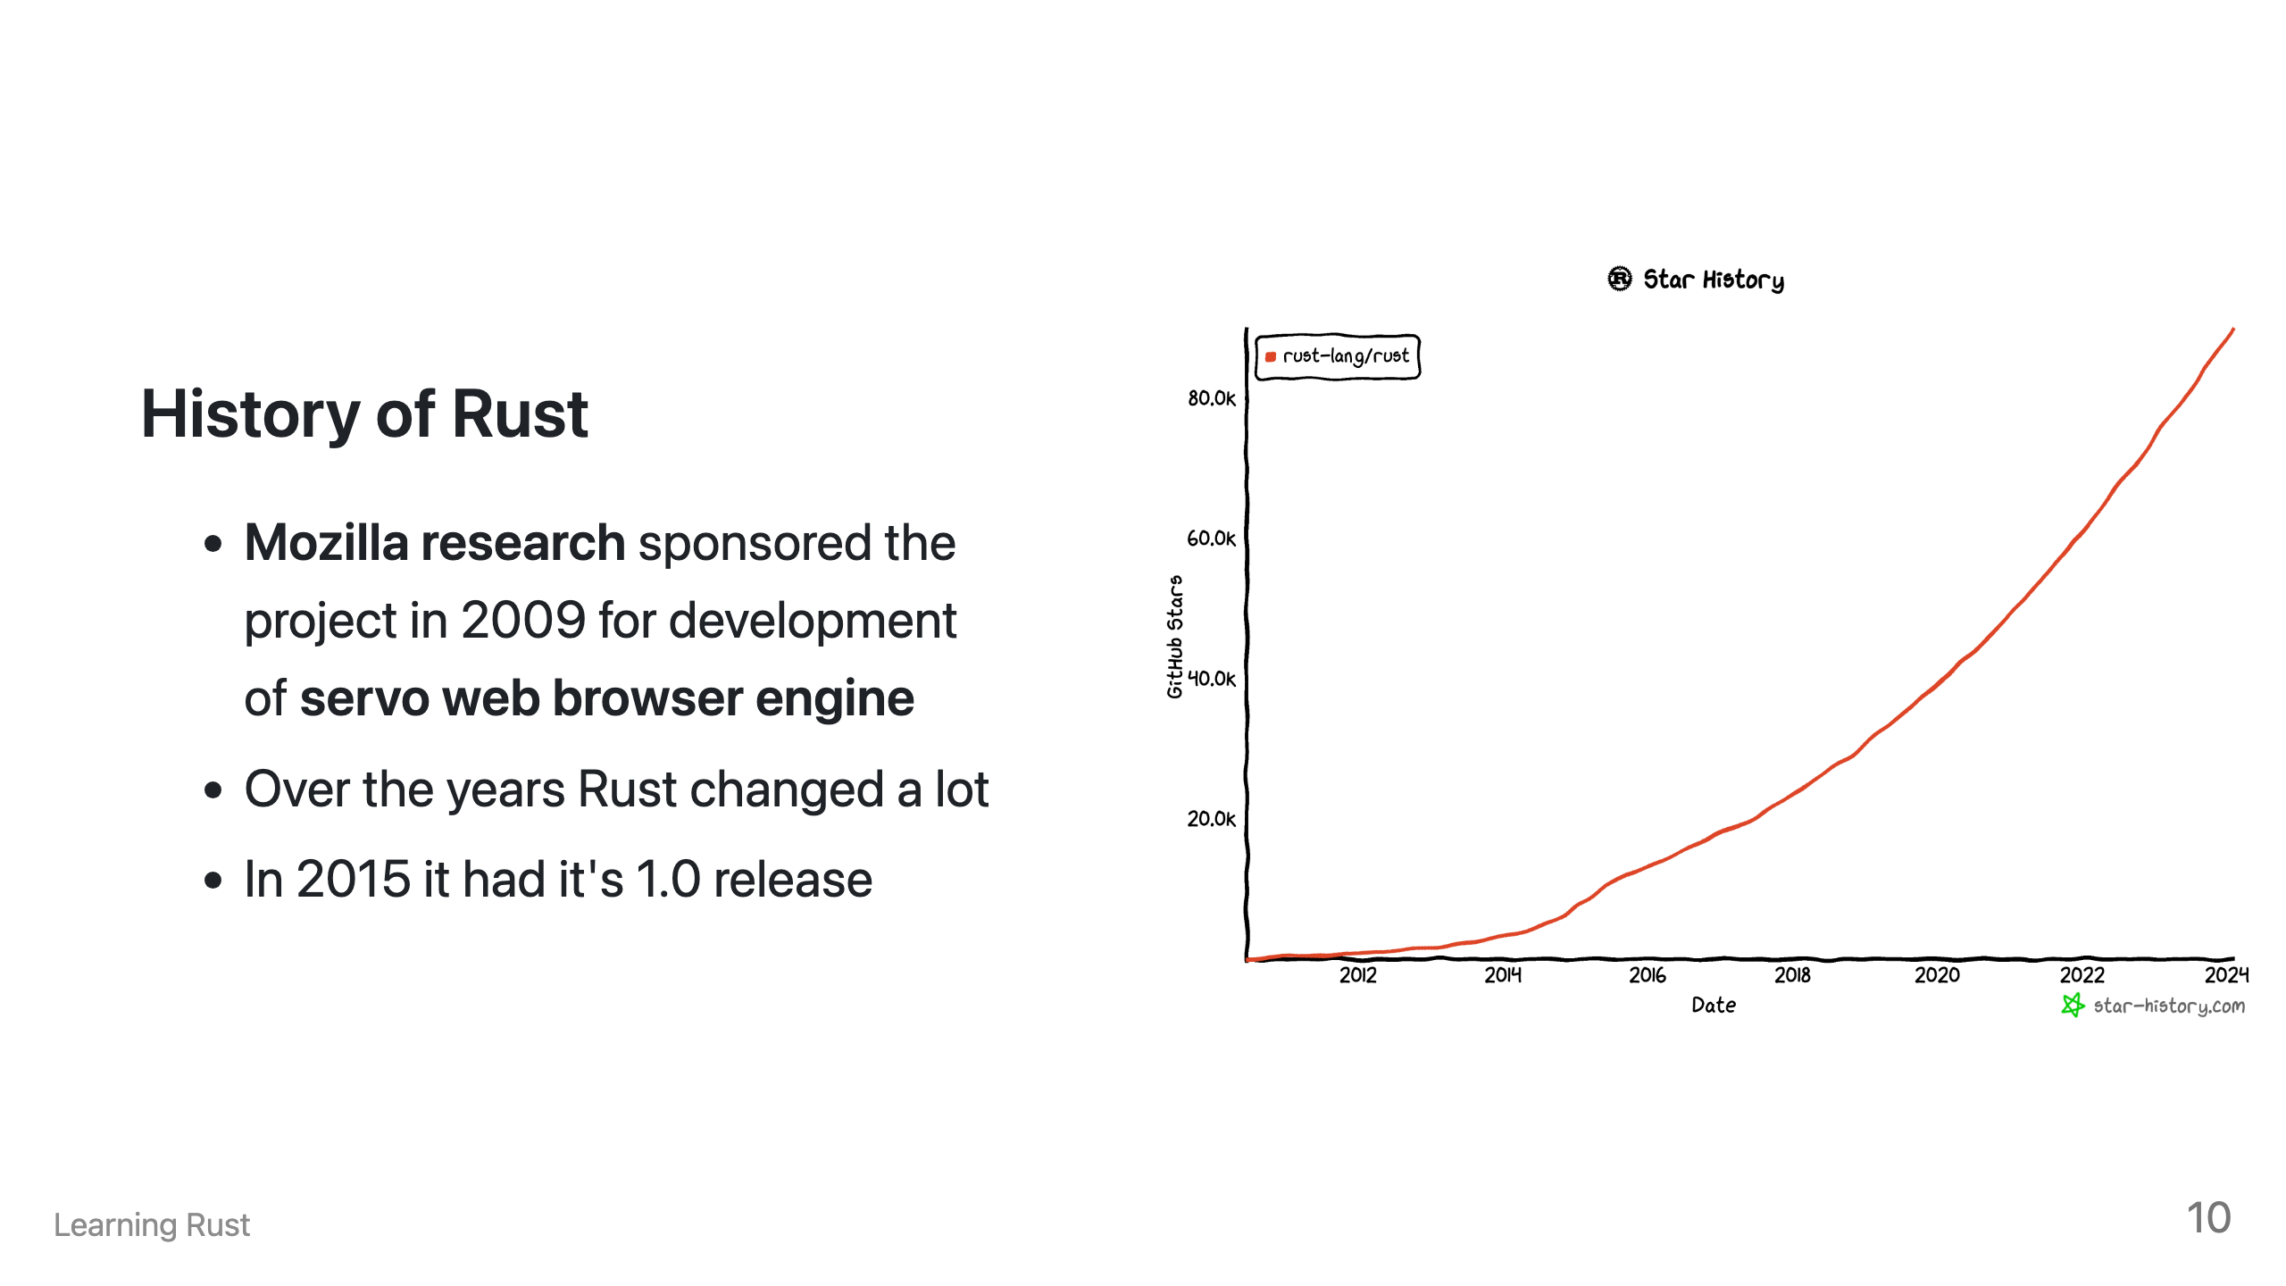
Notes:
- Growing adoption

Slide 12
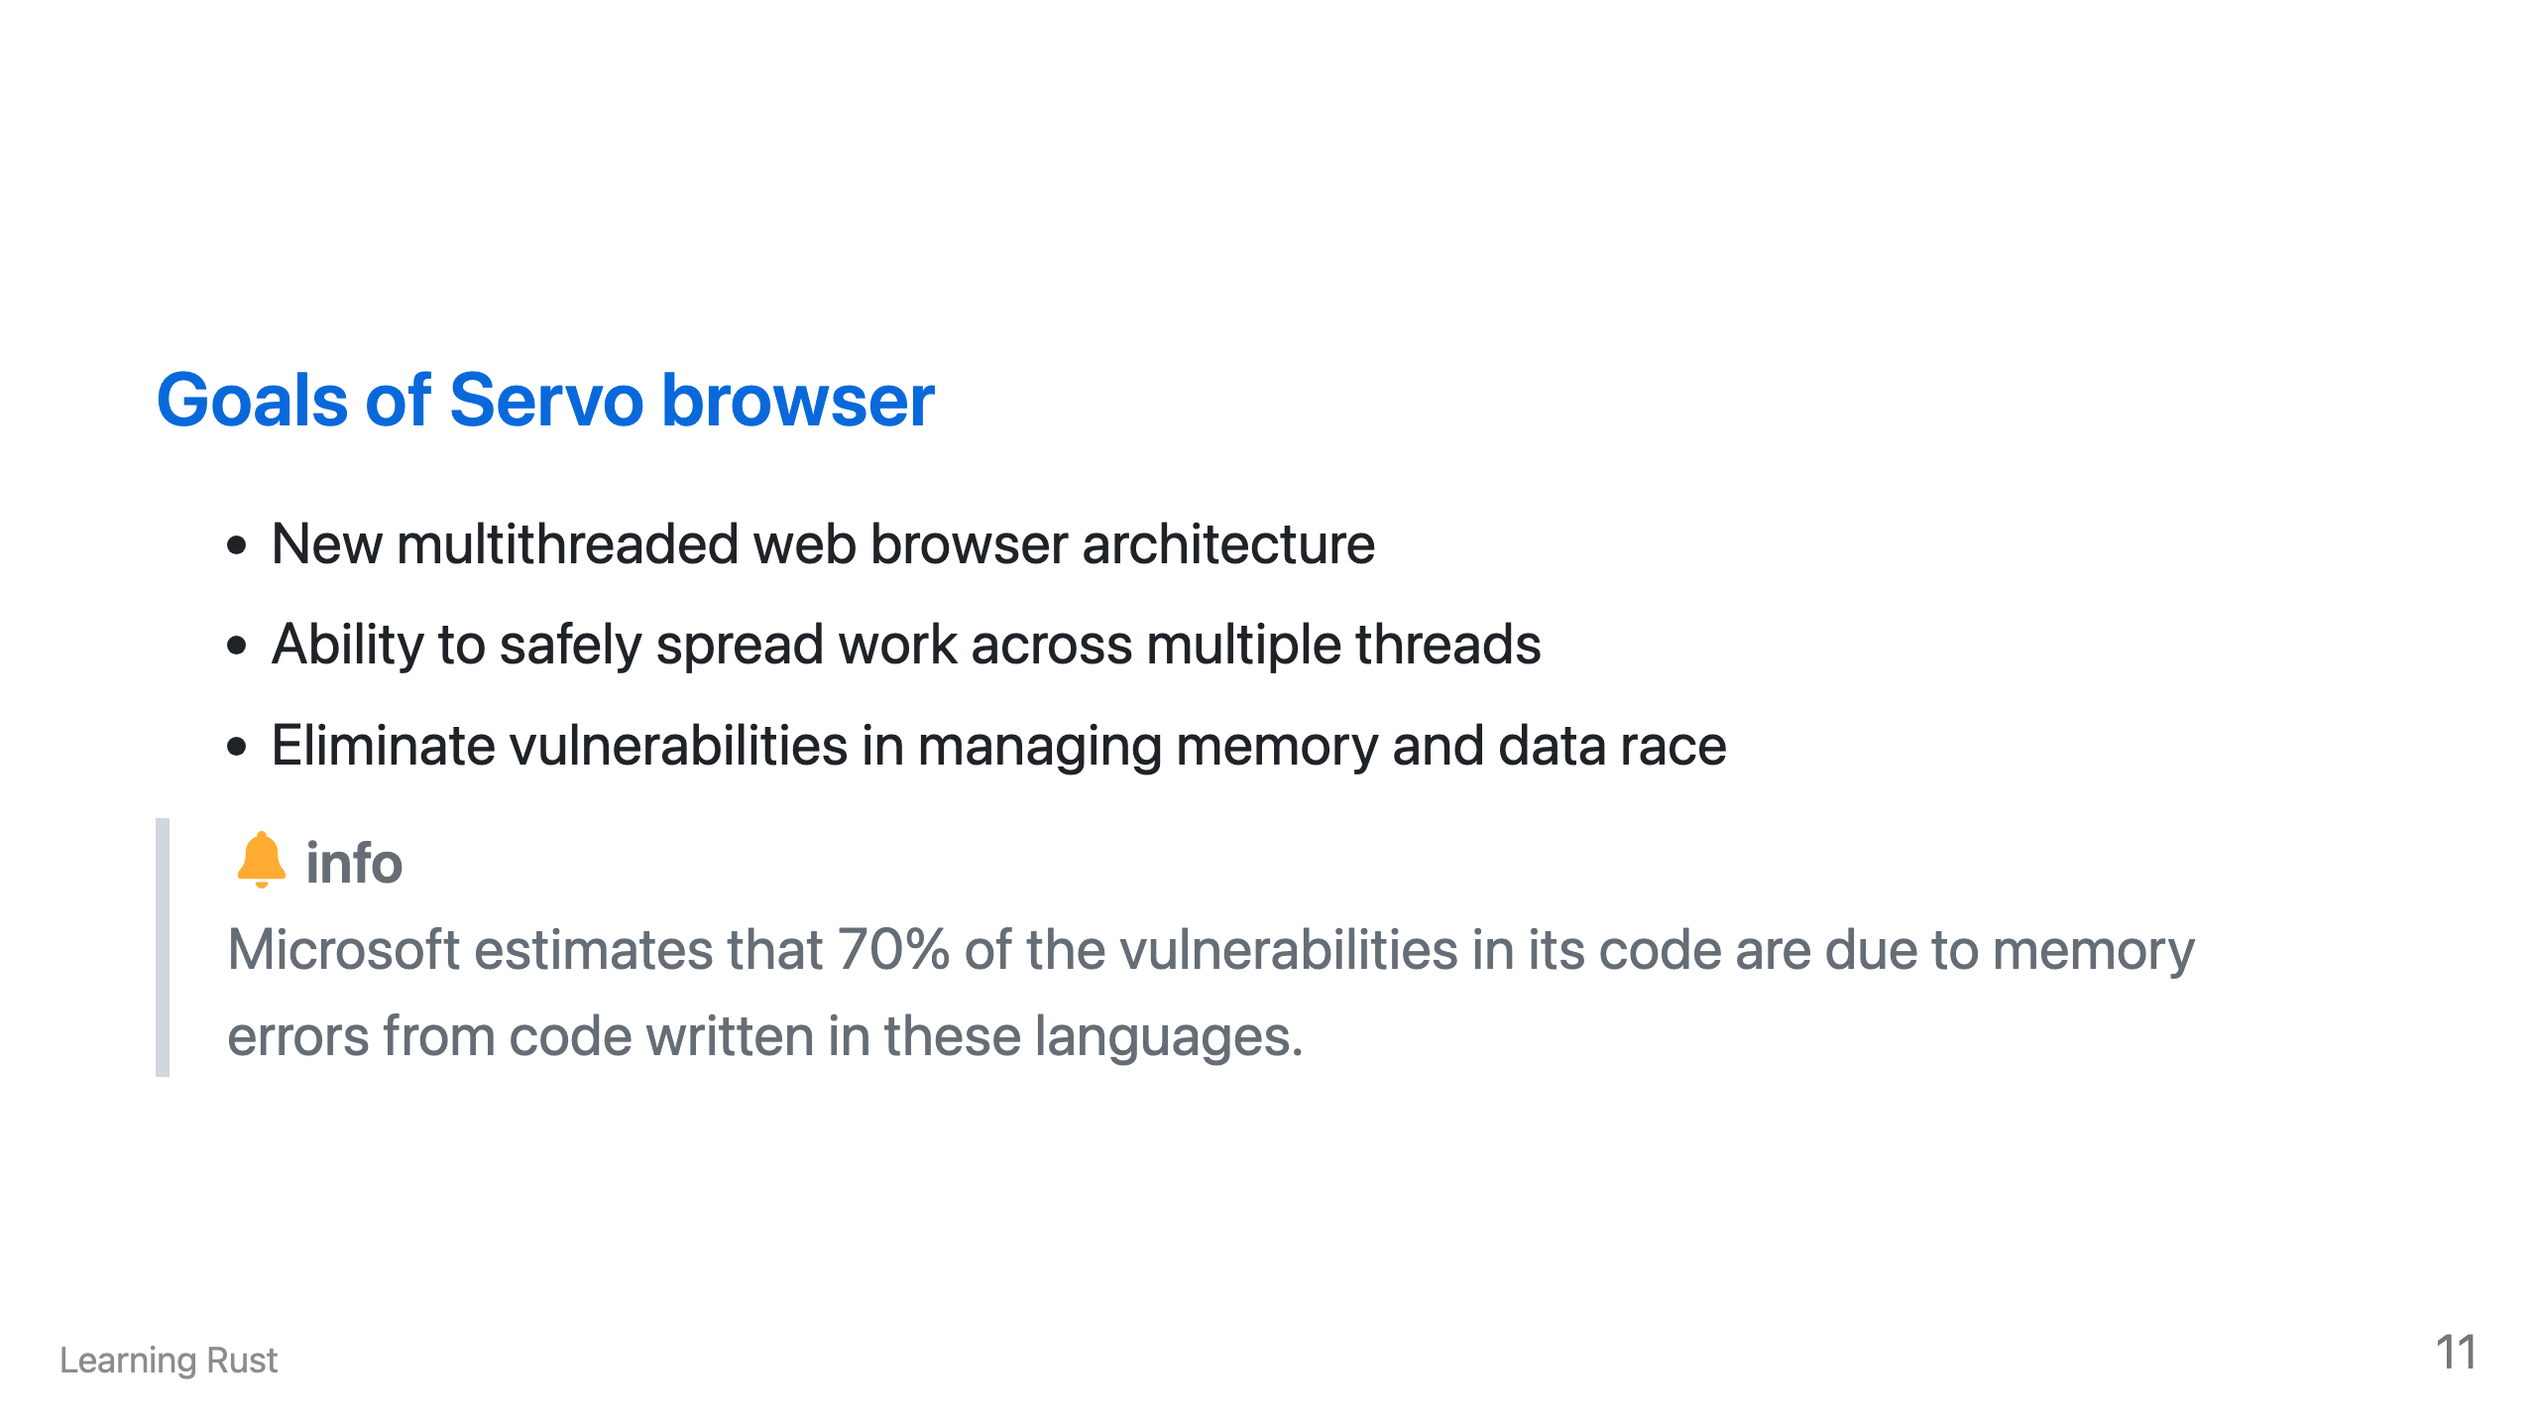
Notes:
Our goal is to create an architecture that takes advantage of parallelism at many levels while eliminating common sources of bugs and security vulnerabilities associated with incorrect memory management and data races. - By spending more time up front, you could just skip programming memory bugs - Browsers are often an attack vector for hackers - What if the program we used could protect us from most attacks? - Main goal was to develop a safer browser engine

Slide 13
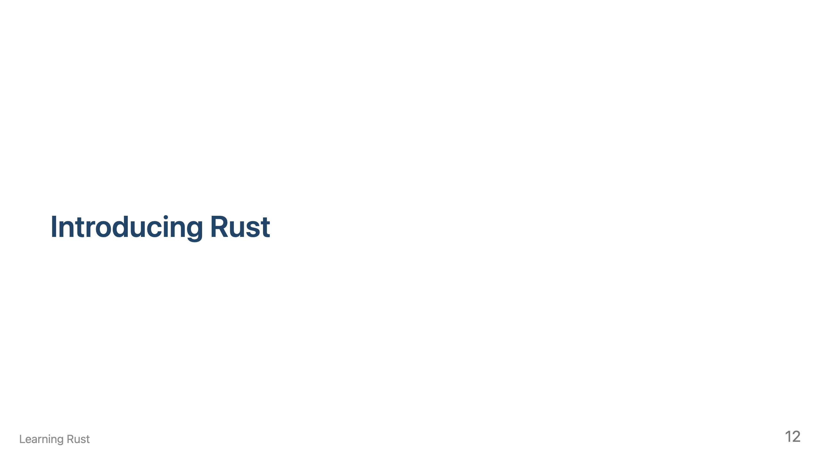

Slide 14


Slide 15
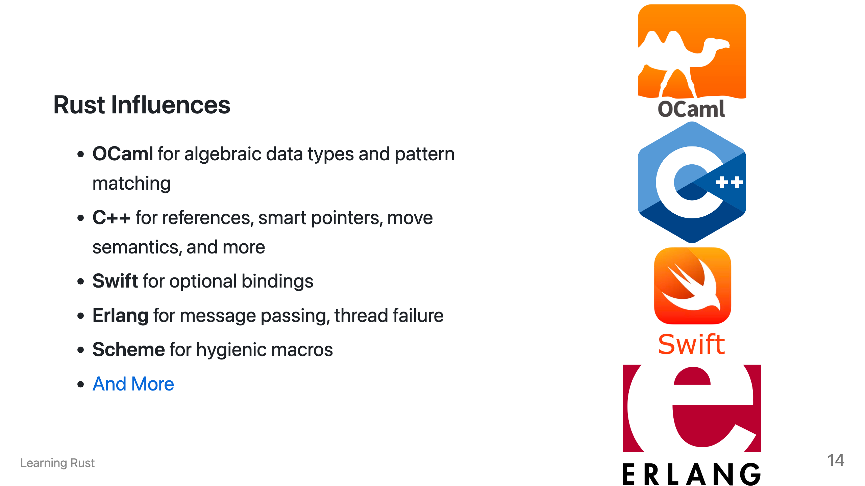
Notes:
Rust is not an original language, instead it's borrowed design elements from a wide variety of languages.

Slide 16
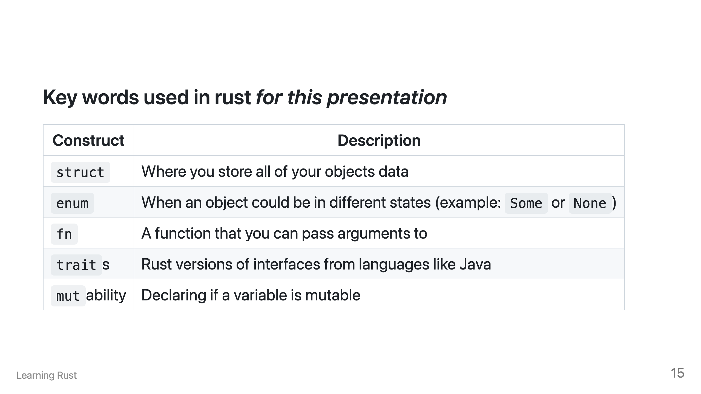
Notes:
Every language has reserved keywords that the language uses. These are some in which we'll be coving today.

Slide 17
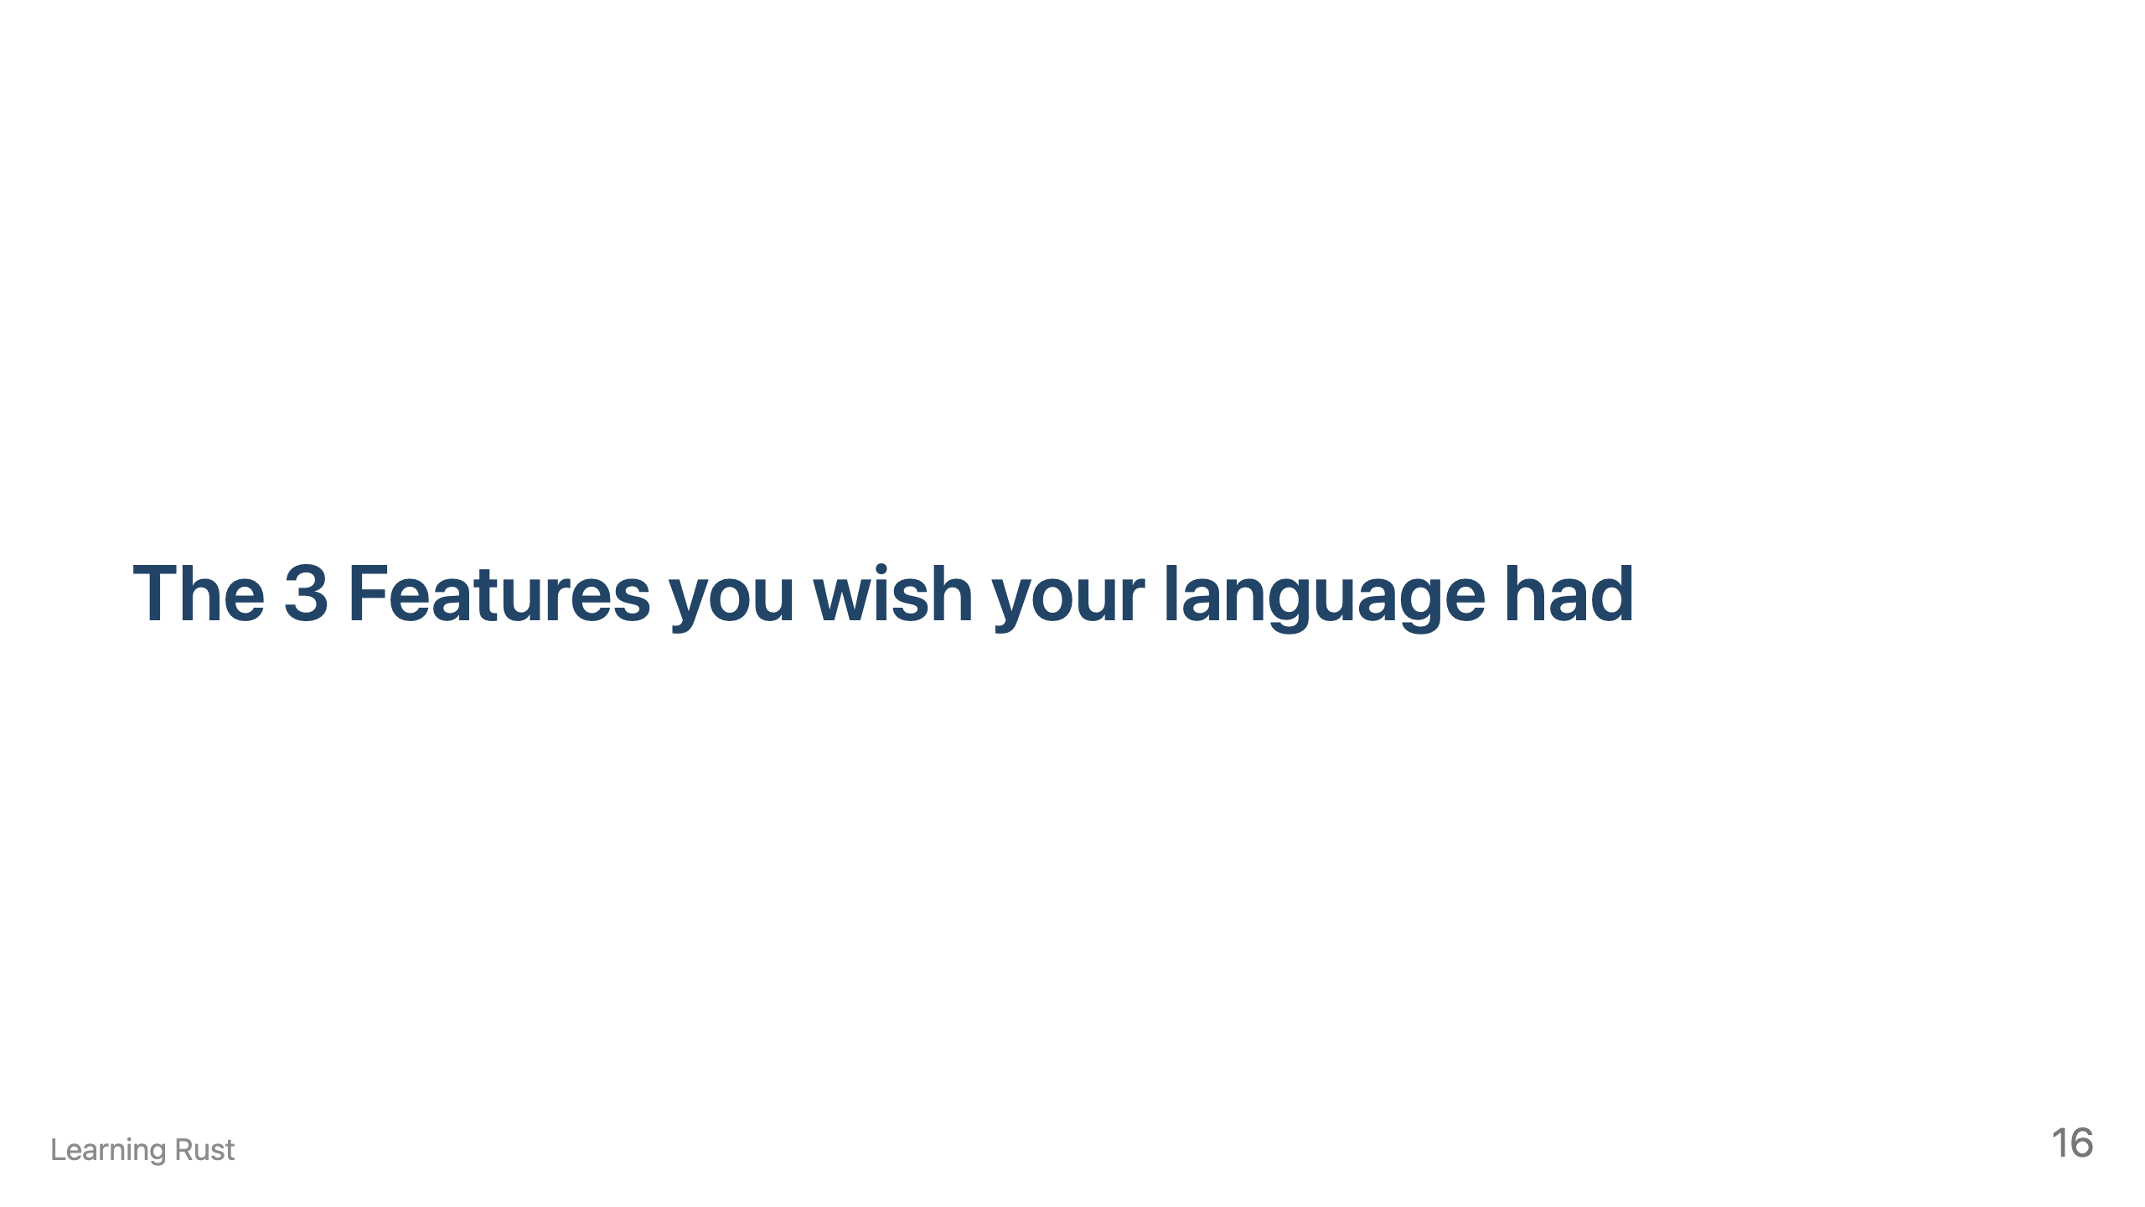

Slide 18
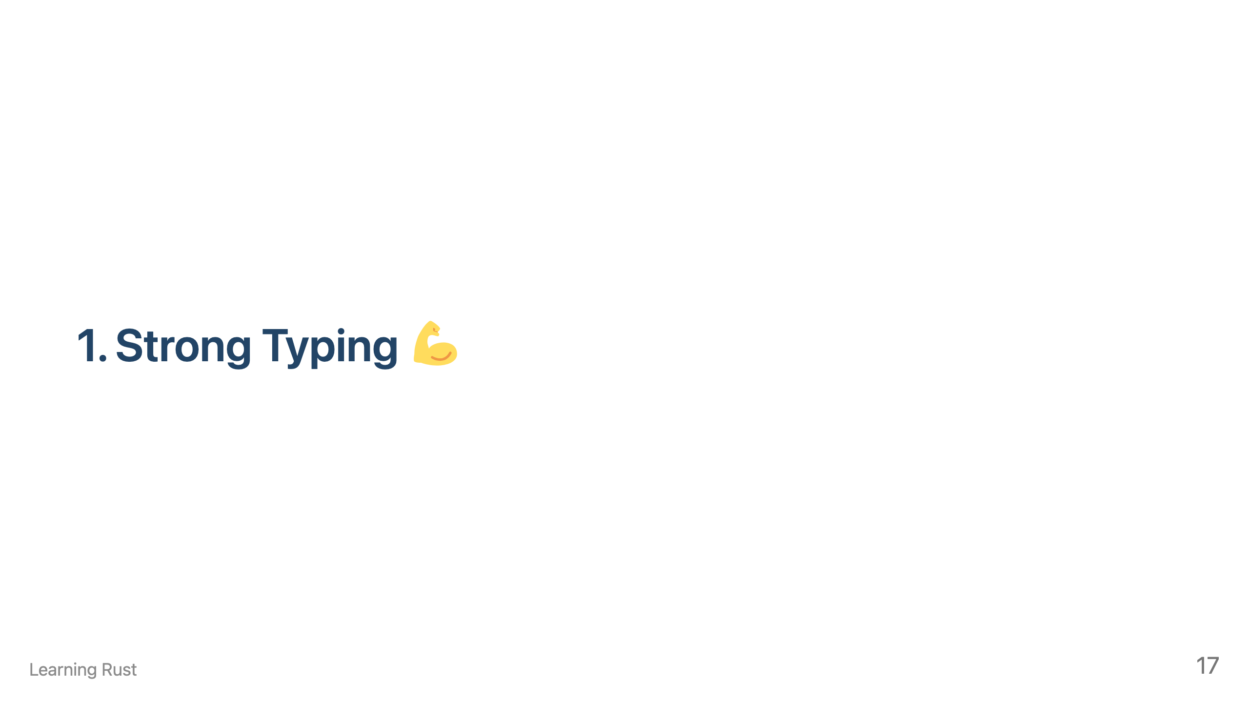

Slide 19
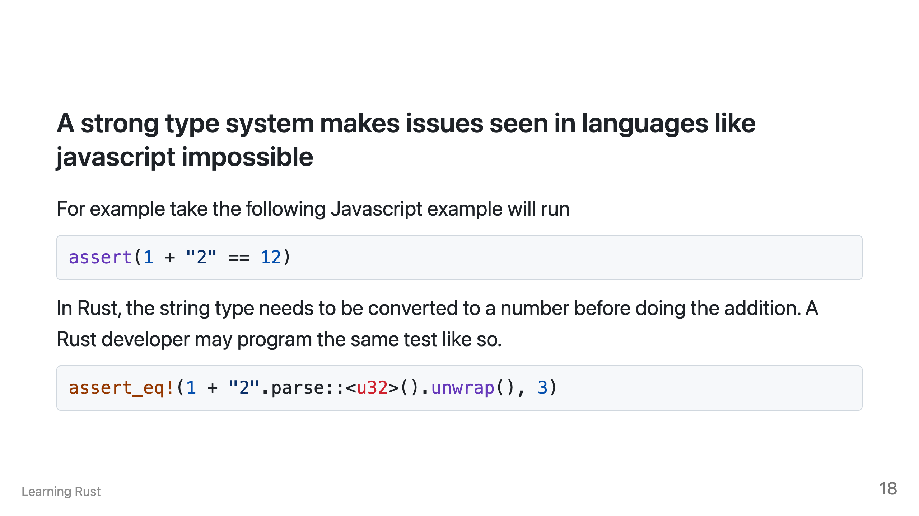

Slide 20
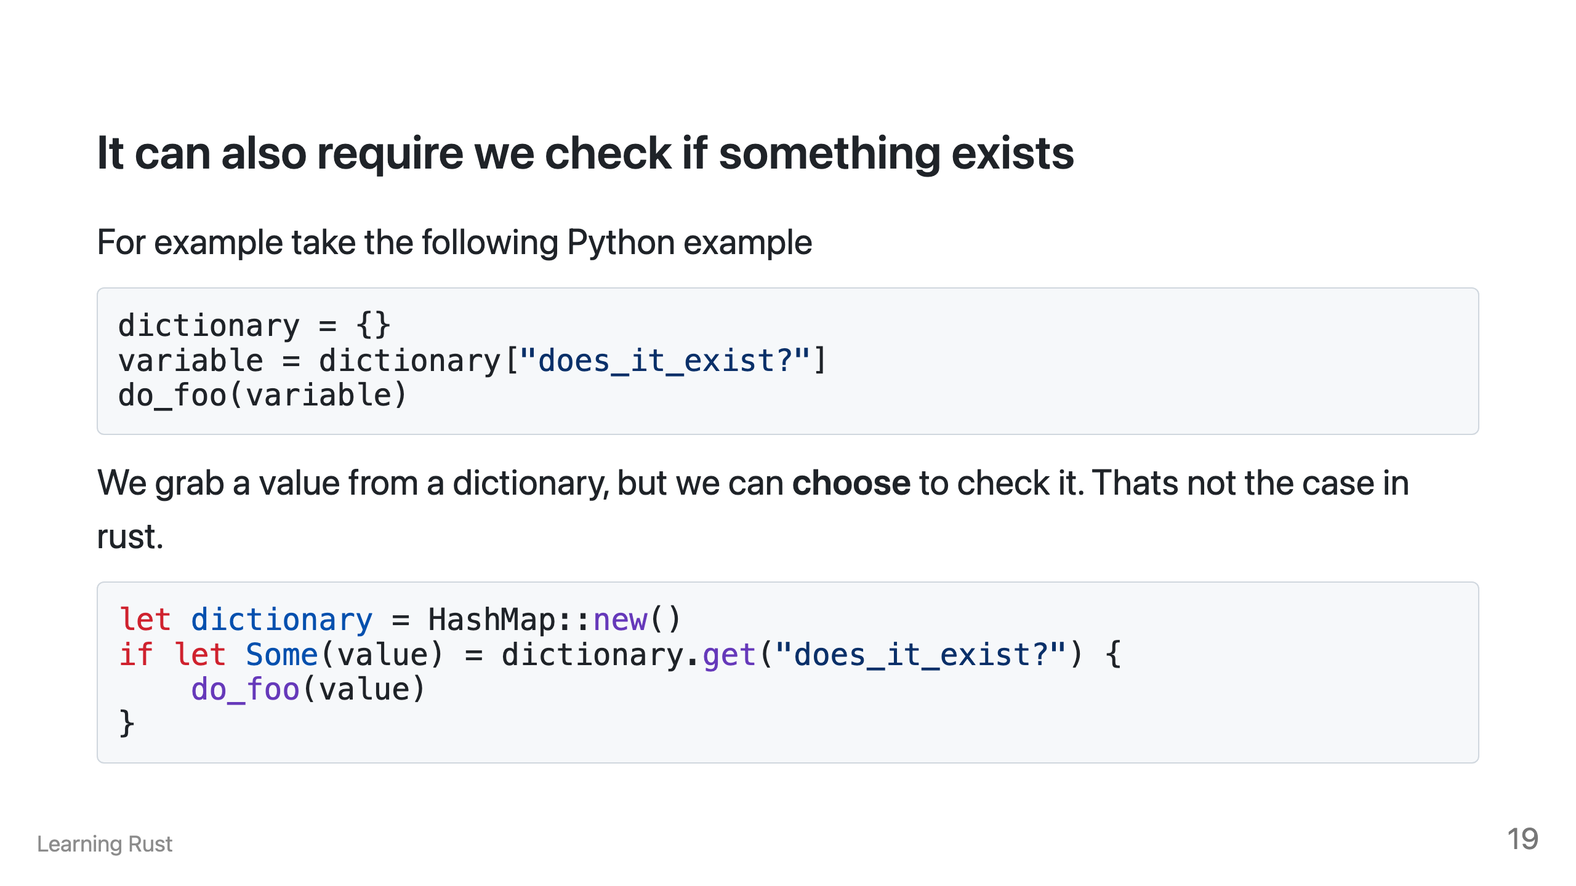

Slide 21
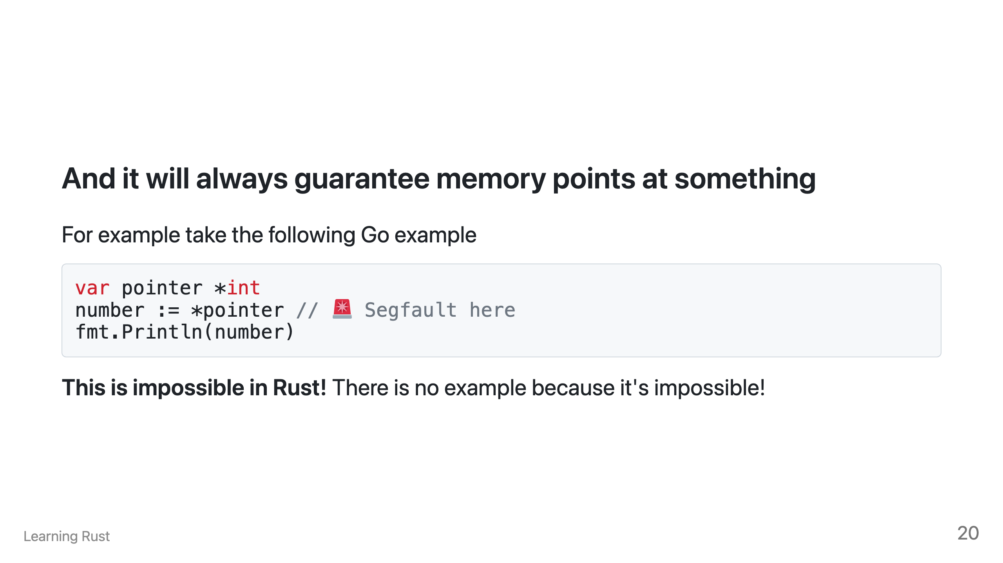

Slide 22
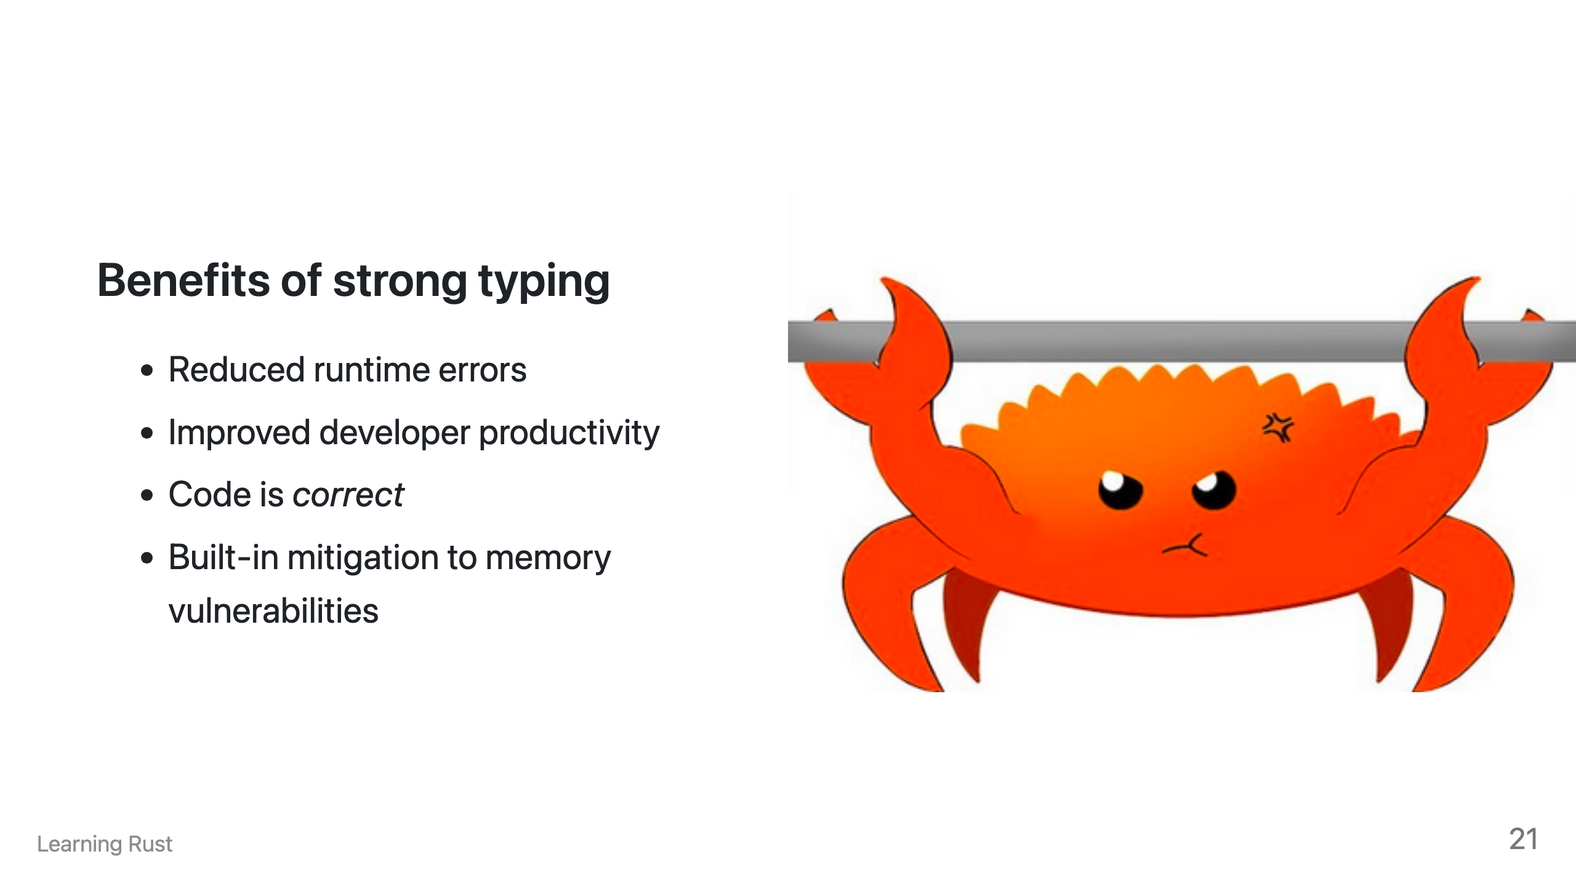
Notes:
Therefore, strong typing is a benefit because it moves the error checking from runtime, to compile time. There is no longer a need to test your programming running because the type system will provide if that thing works. Rust is forcing you to put all these types around your program, like many small unit tests. They bake your assumptions about the code into the program. Compare this to dynamic language's where it's expected for you to write assumptions as unit tests. However I'm sure everyone in this call knows how often that happens. (Which is not a lot)! Strong typing makes writing correct code, code that does what you expect easier. By spending more time up front coding, you'll no longer need to spend more time debugging your code at runtime. Finally, because of all of these requirements implemented by the type system, a lot of memory class issues and vulnerabilities don't need to be planned for because the system protects you from doing the wrong thing.

Slide 23
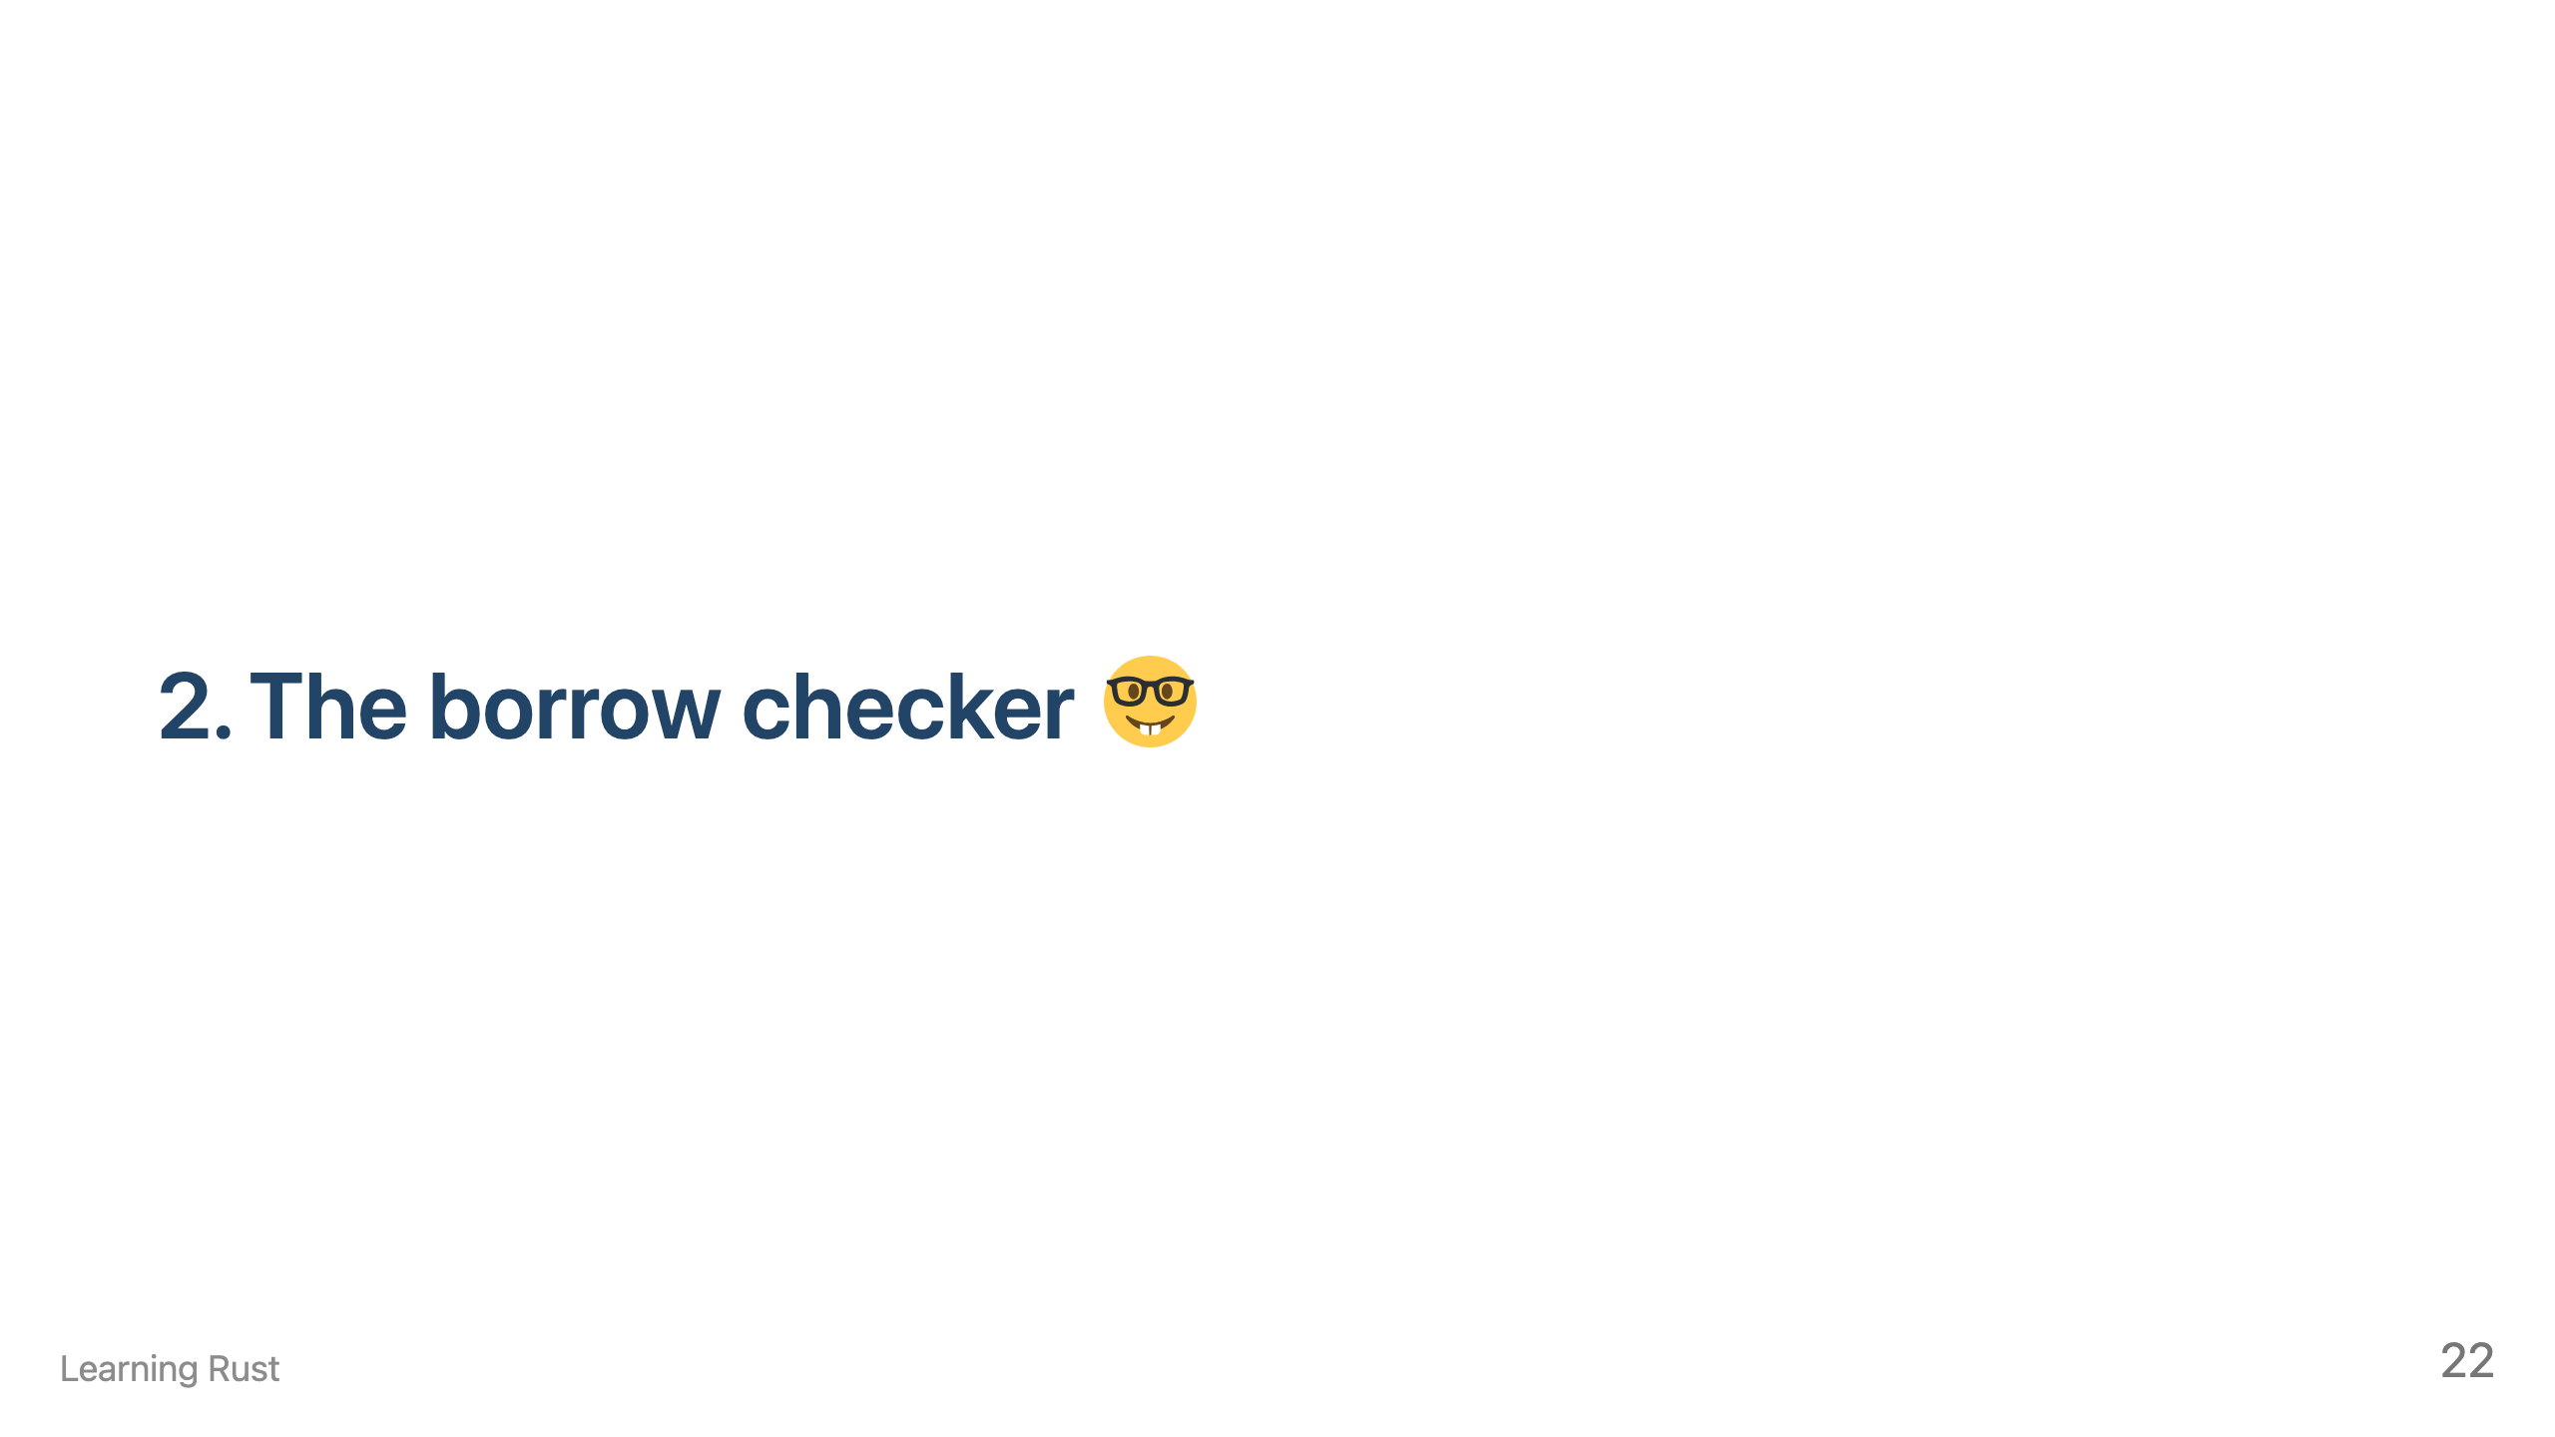

Slide 24
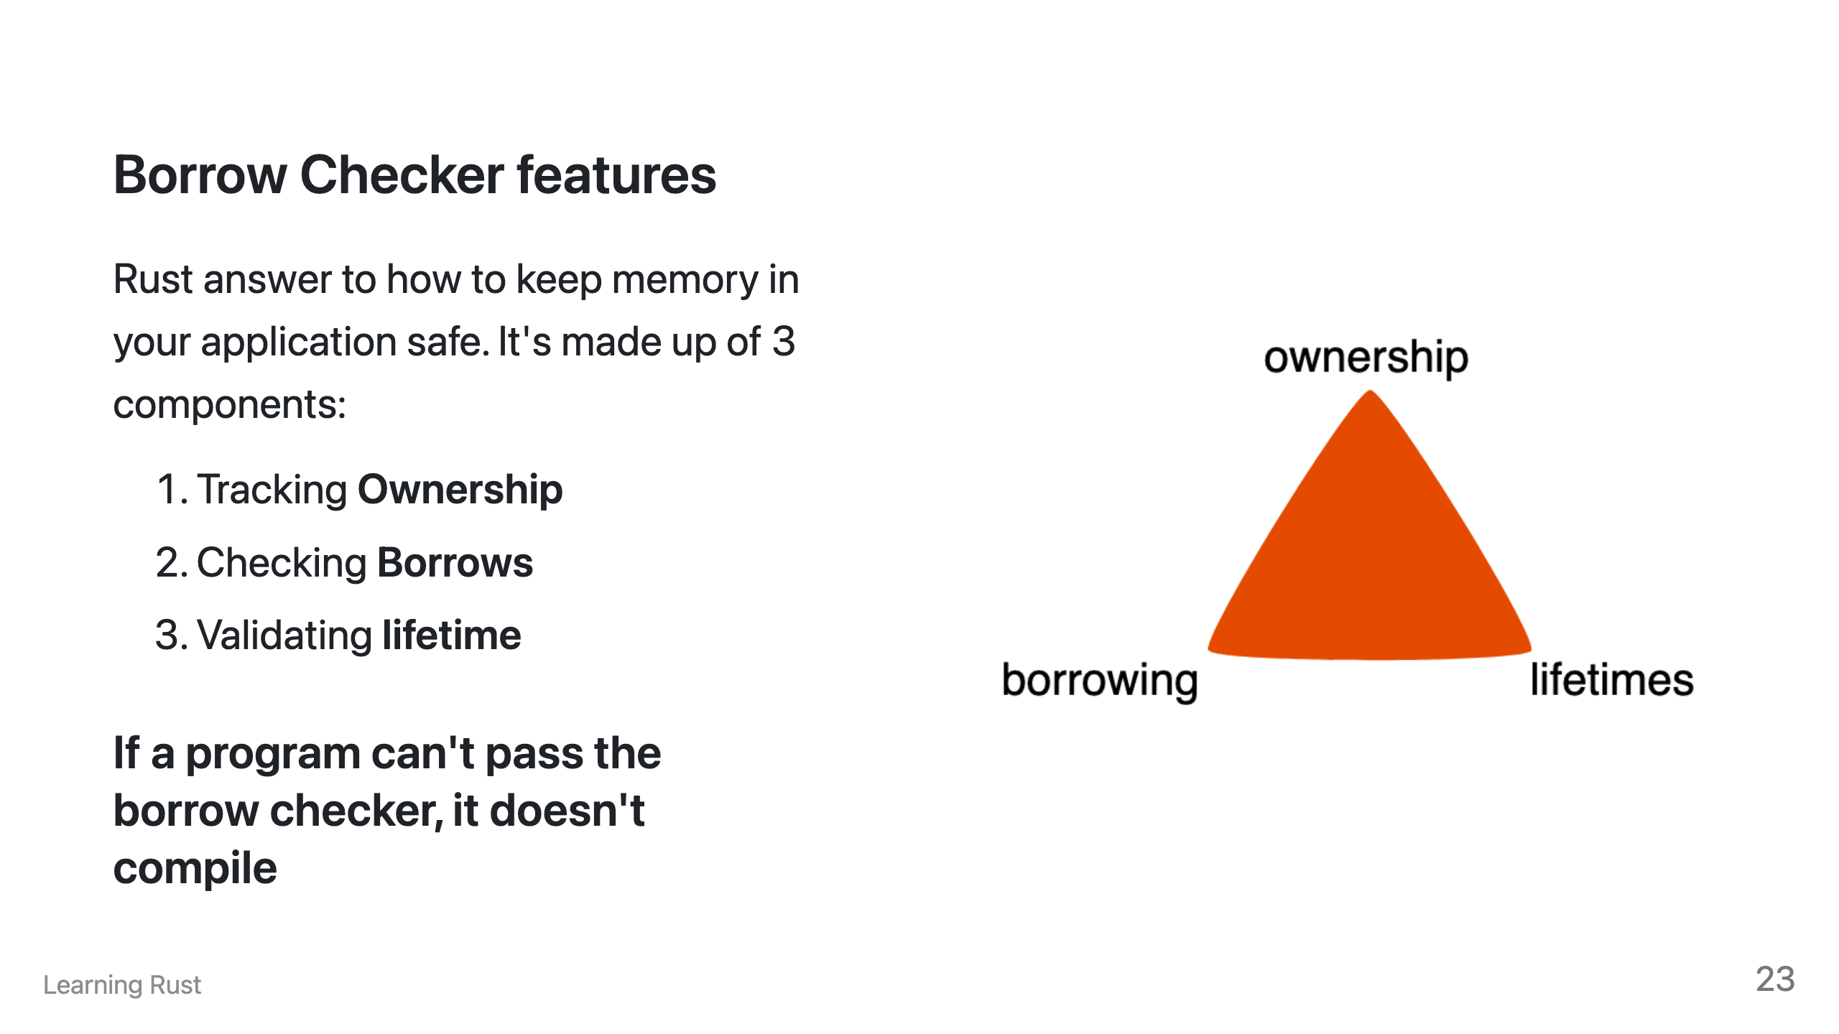
Notes:
![bg right:40%](image-13.png)

Slide 25
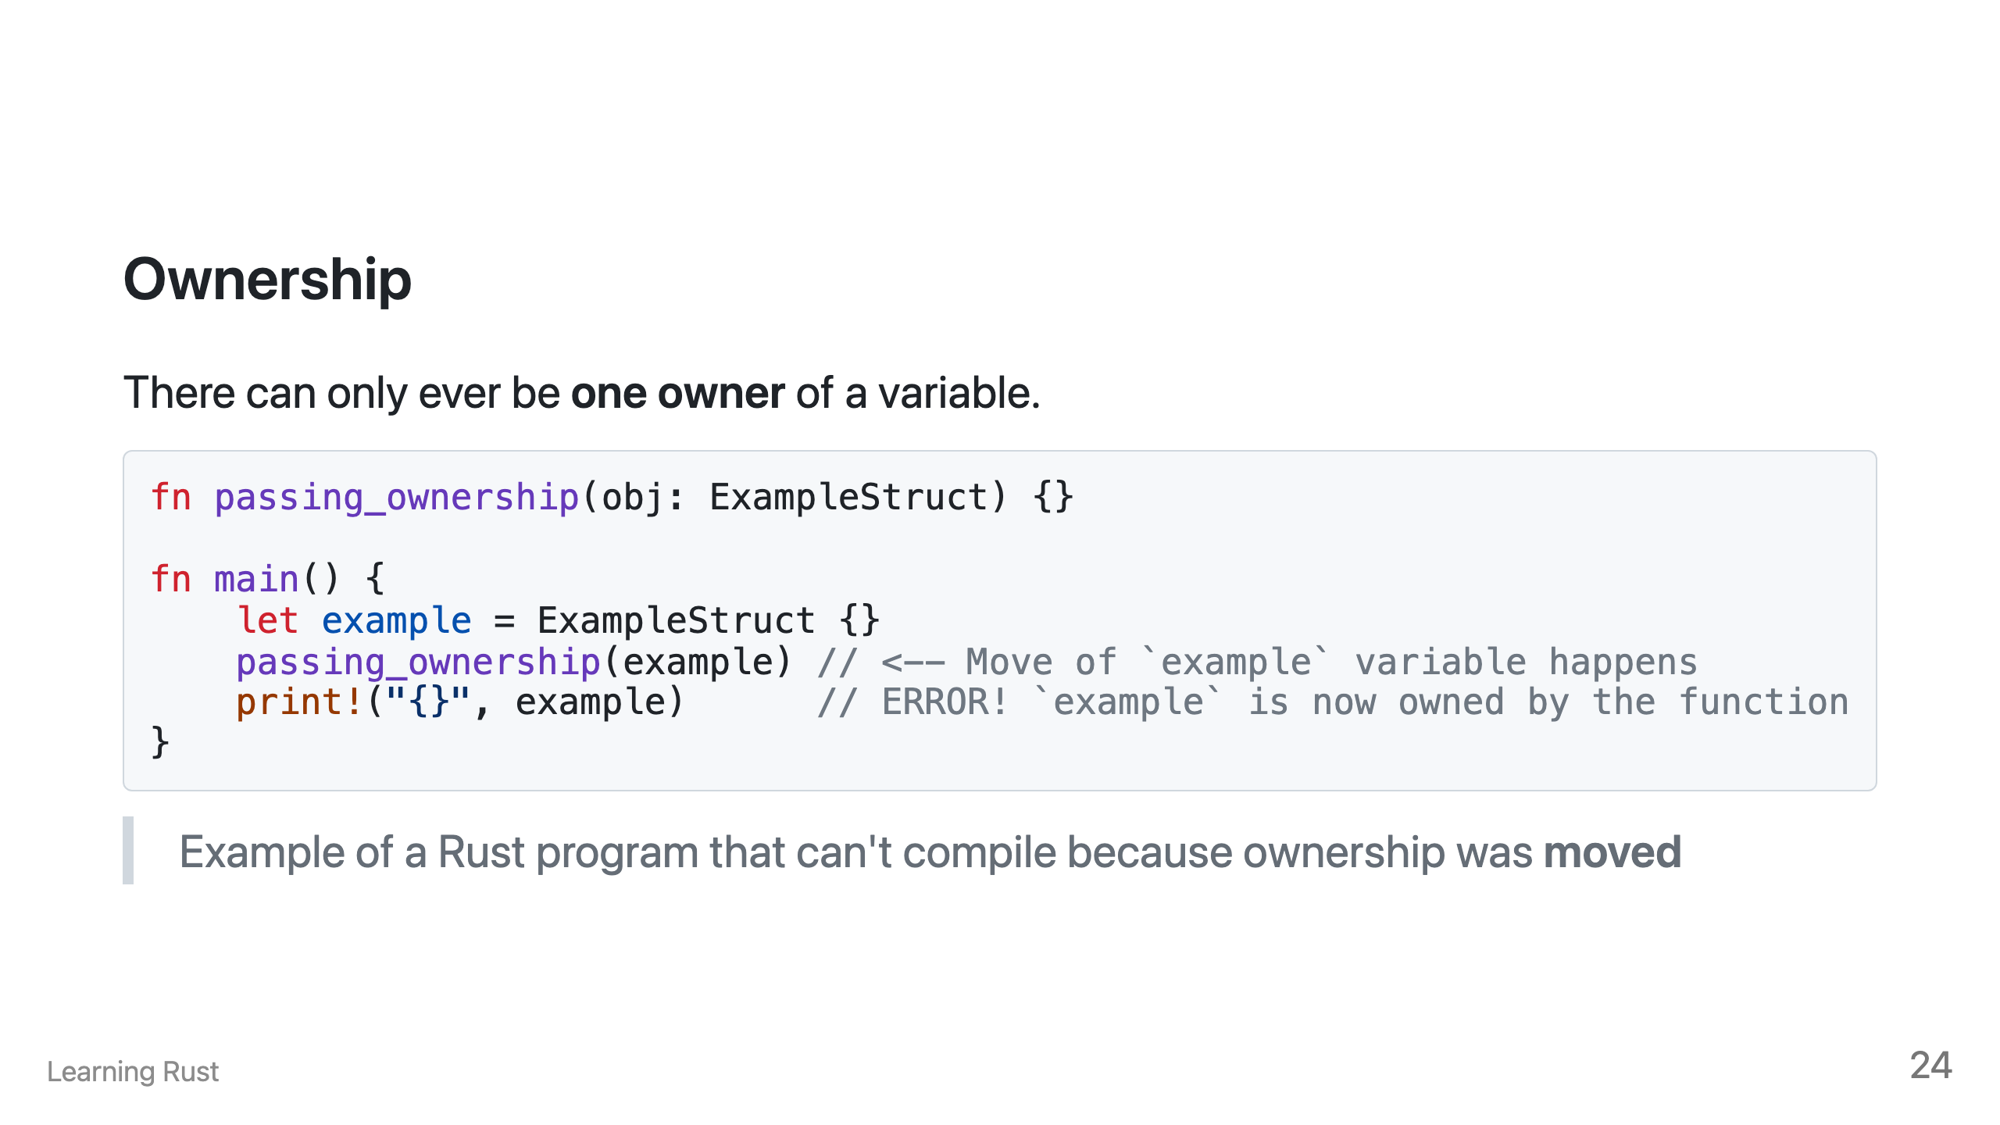

Slide 26
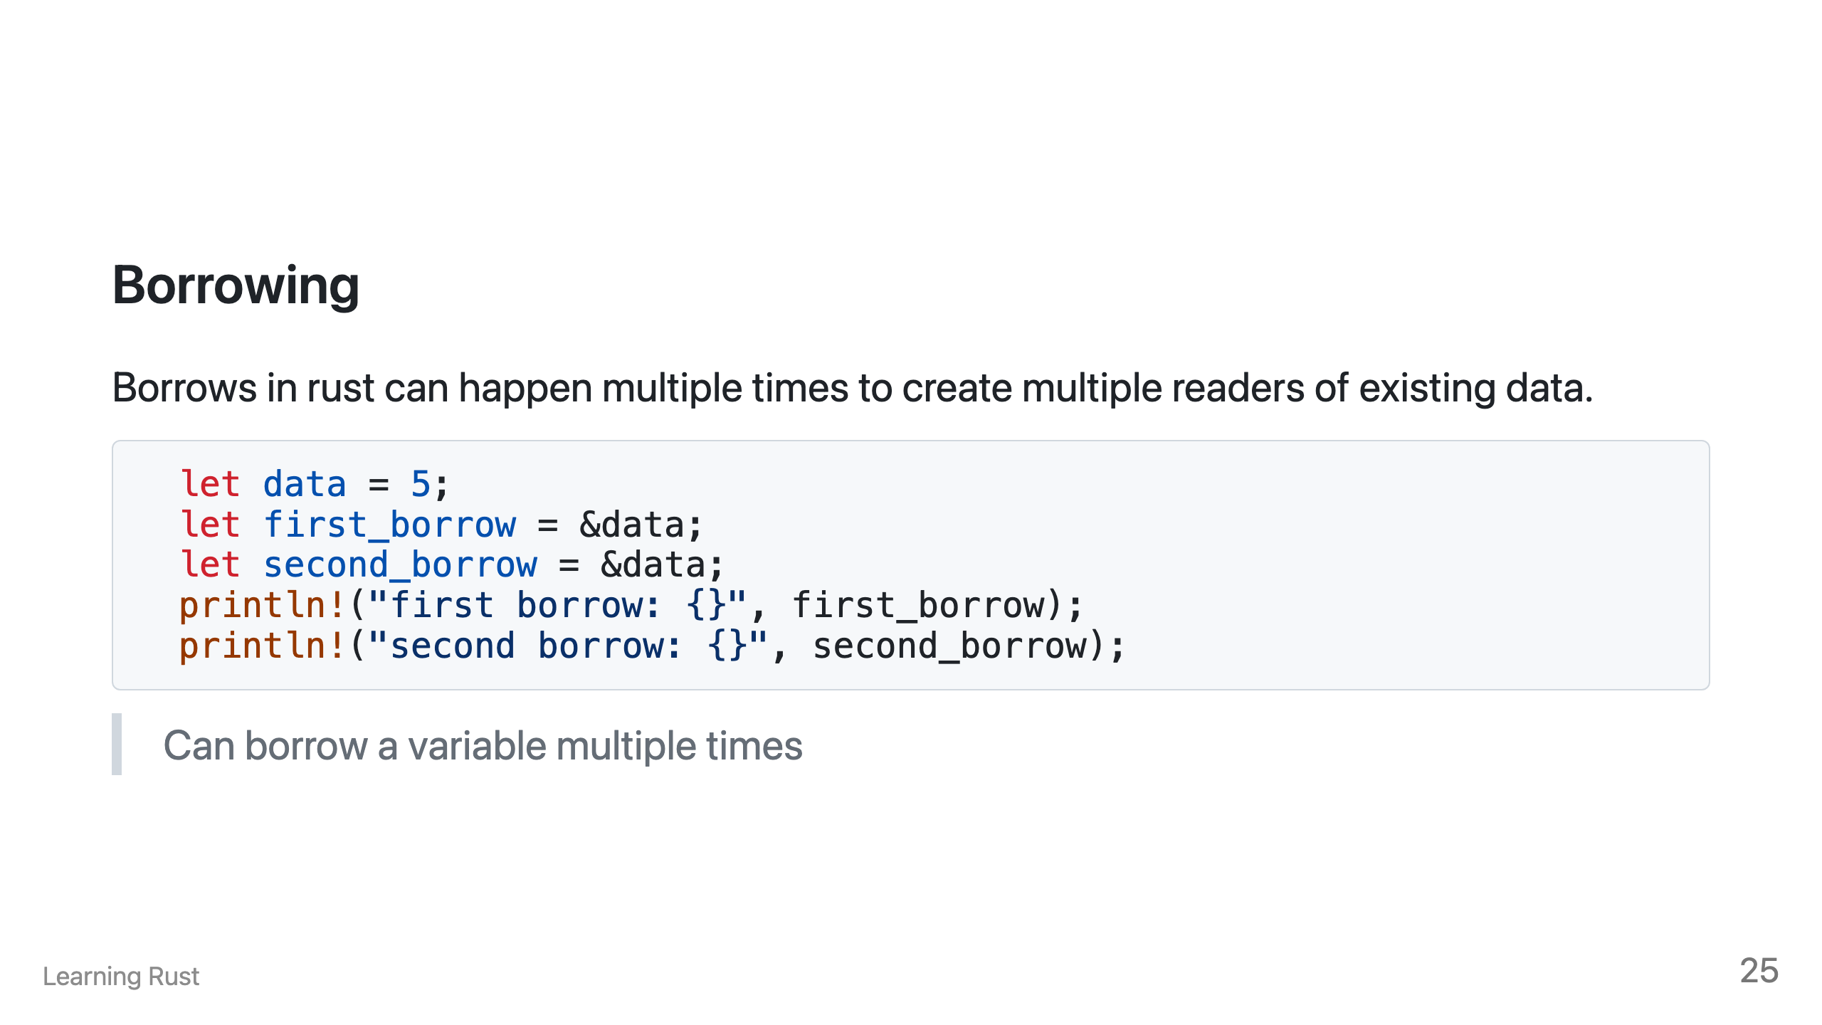

Slide 27
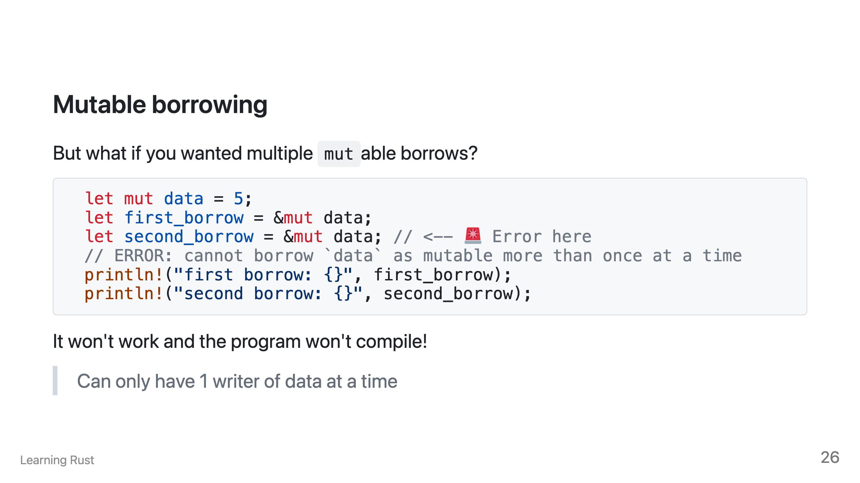

Slide 28
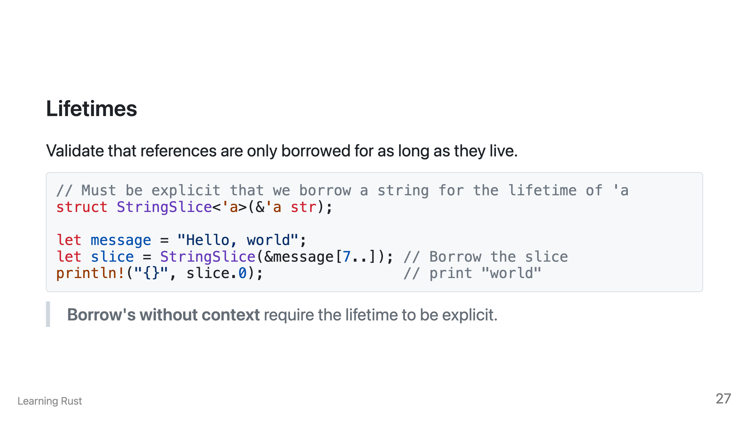

Slide 29
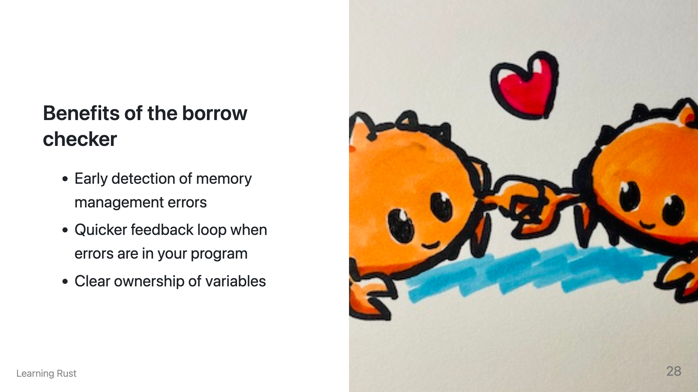
Notes:
Using ownership, borrowing and lifetime features, Rust is able to enforce that at all time in a Rust program, there is only ever 1 writer and multiple readers of variables. This provides safety from data races every showing up in your program. It also guards common errors from occurring such as use after free. This is where memory has been released by the operating system but a reference to that memory location still exists. Finally, the borrow checker and strict typing work together to show clear owner- ship of a variable. With Rust, it's easy to determine if you are altering a reference or the underlying variable.

Slide 30
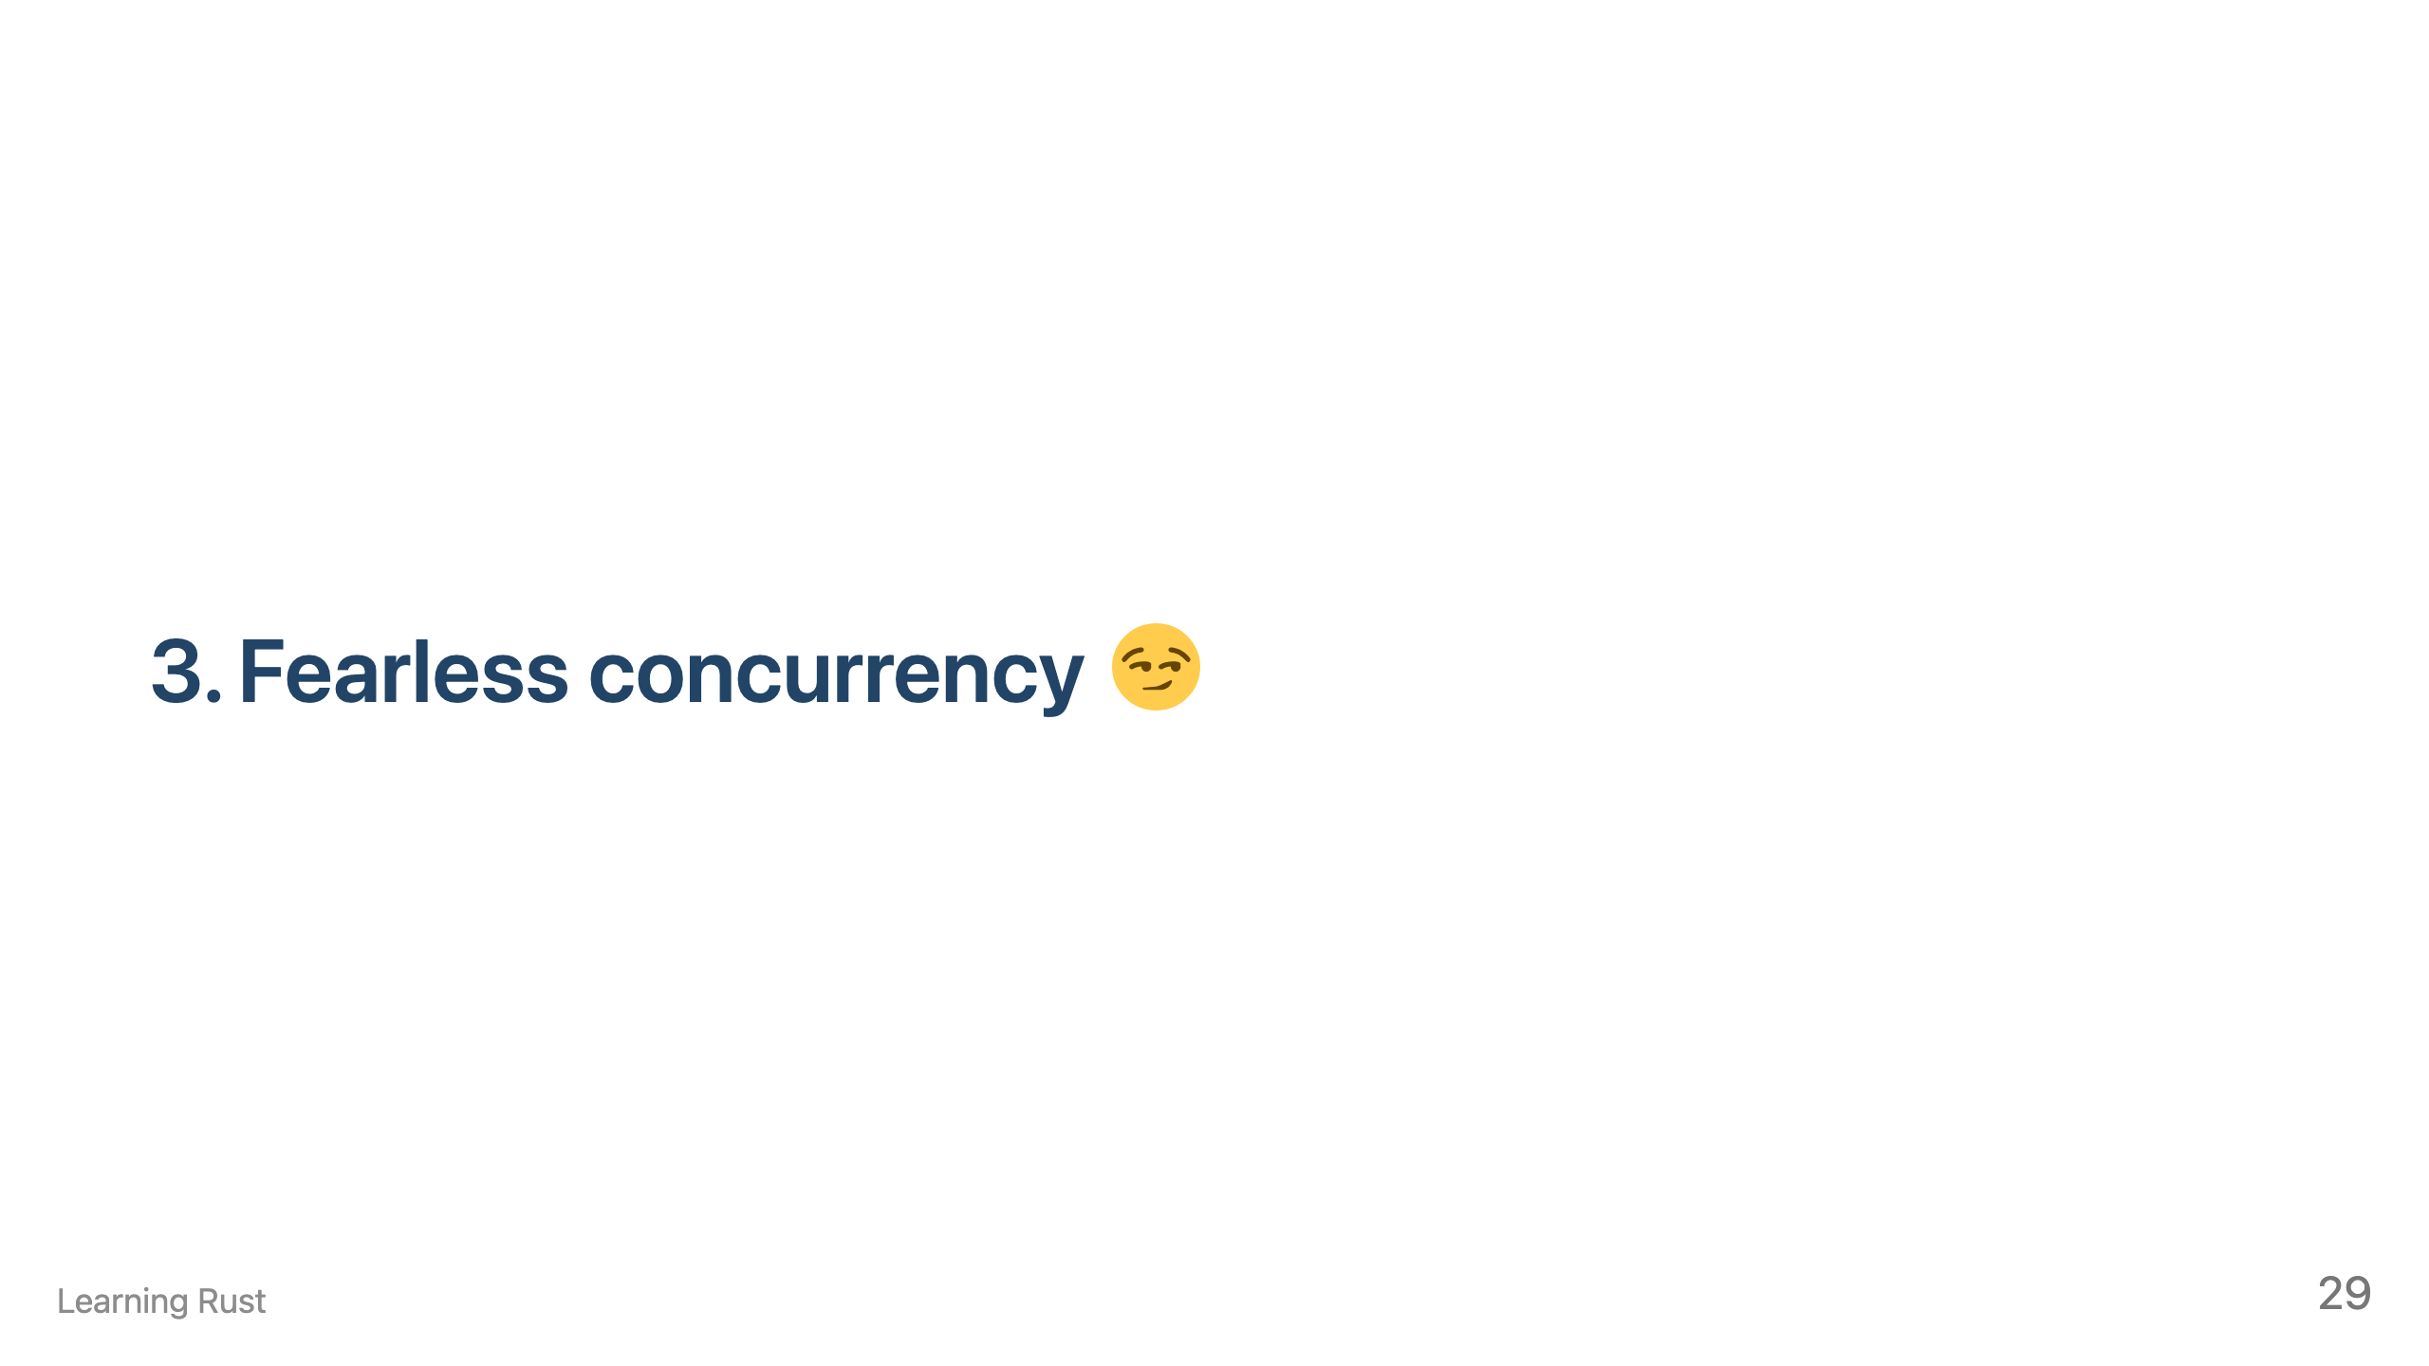

Slide 31
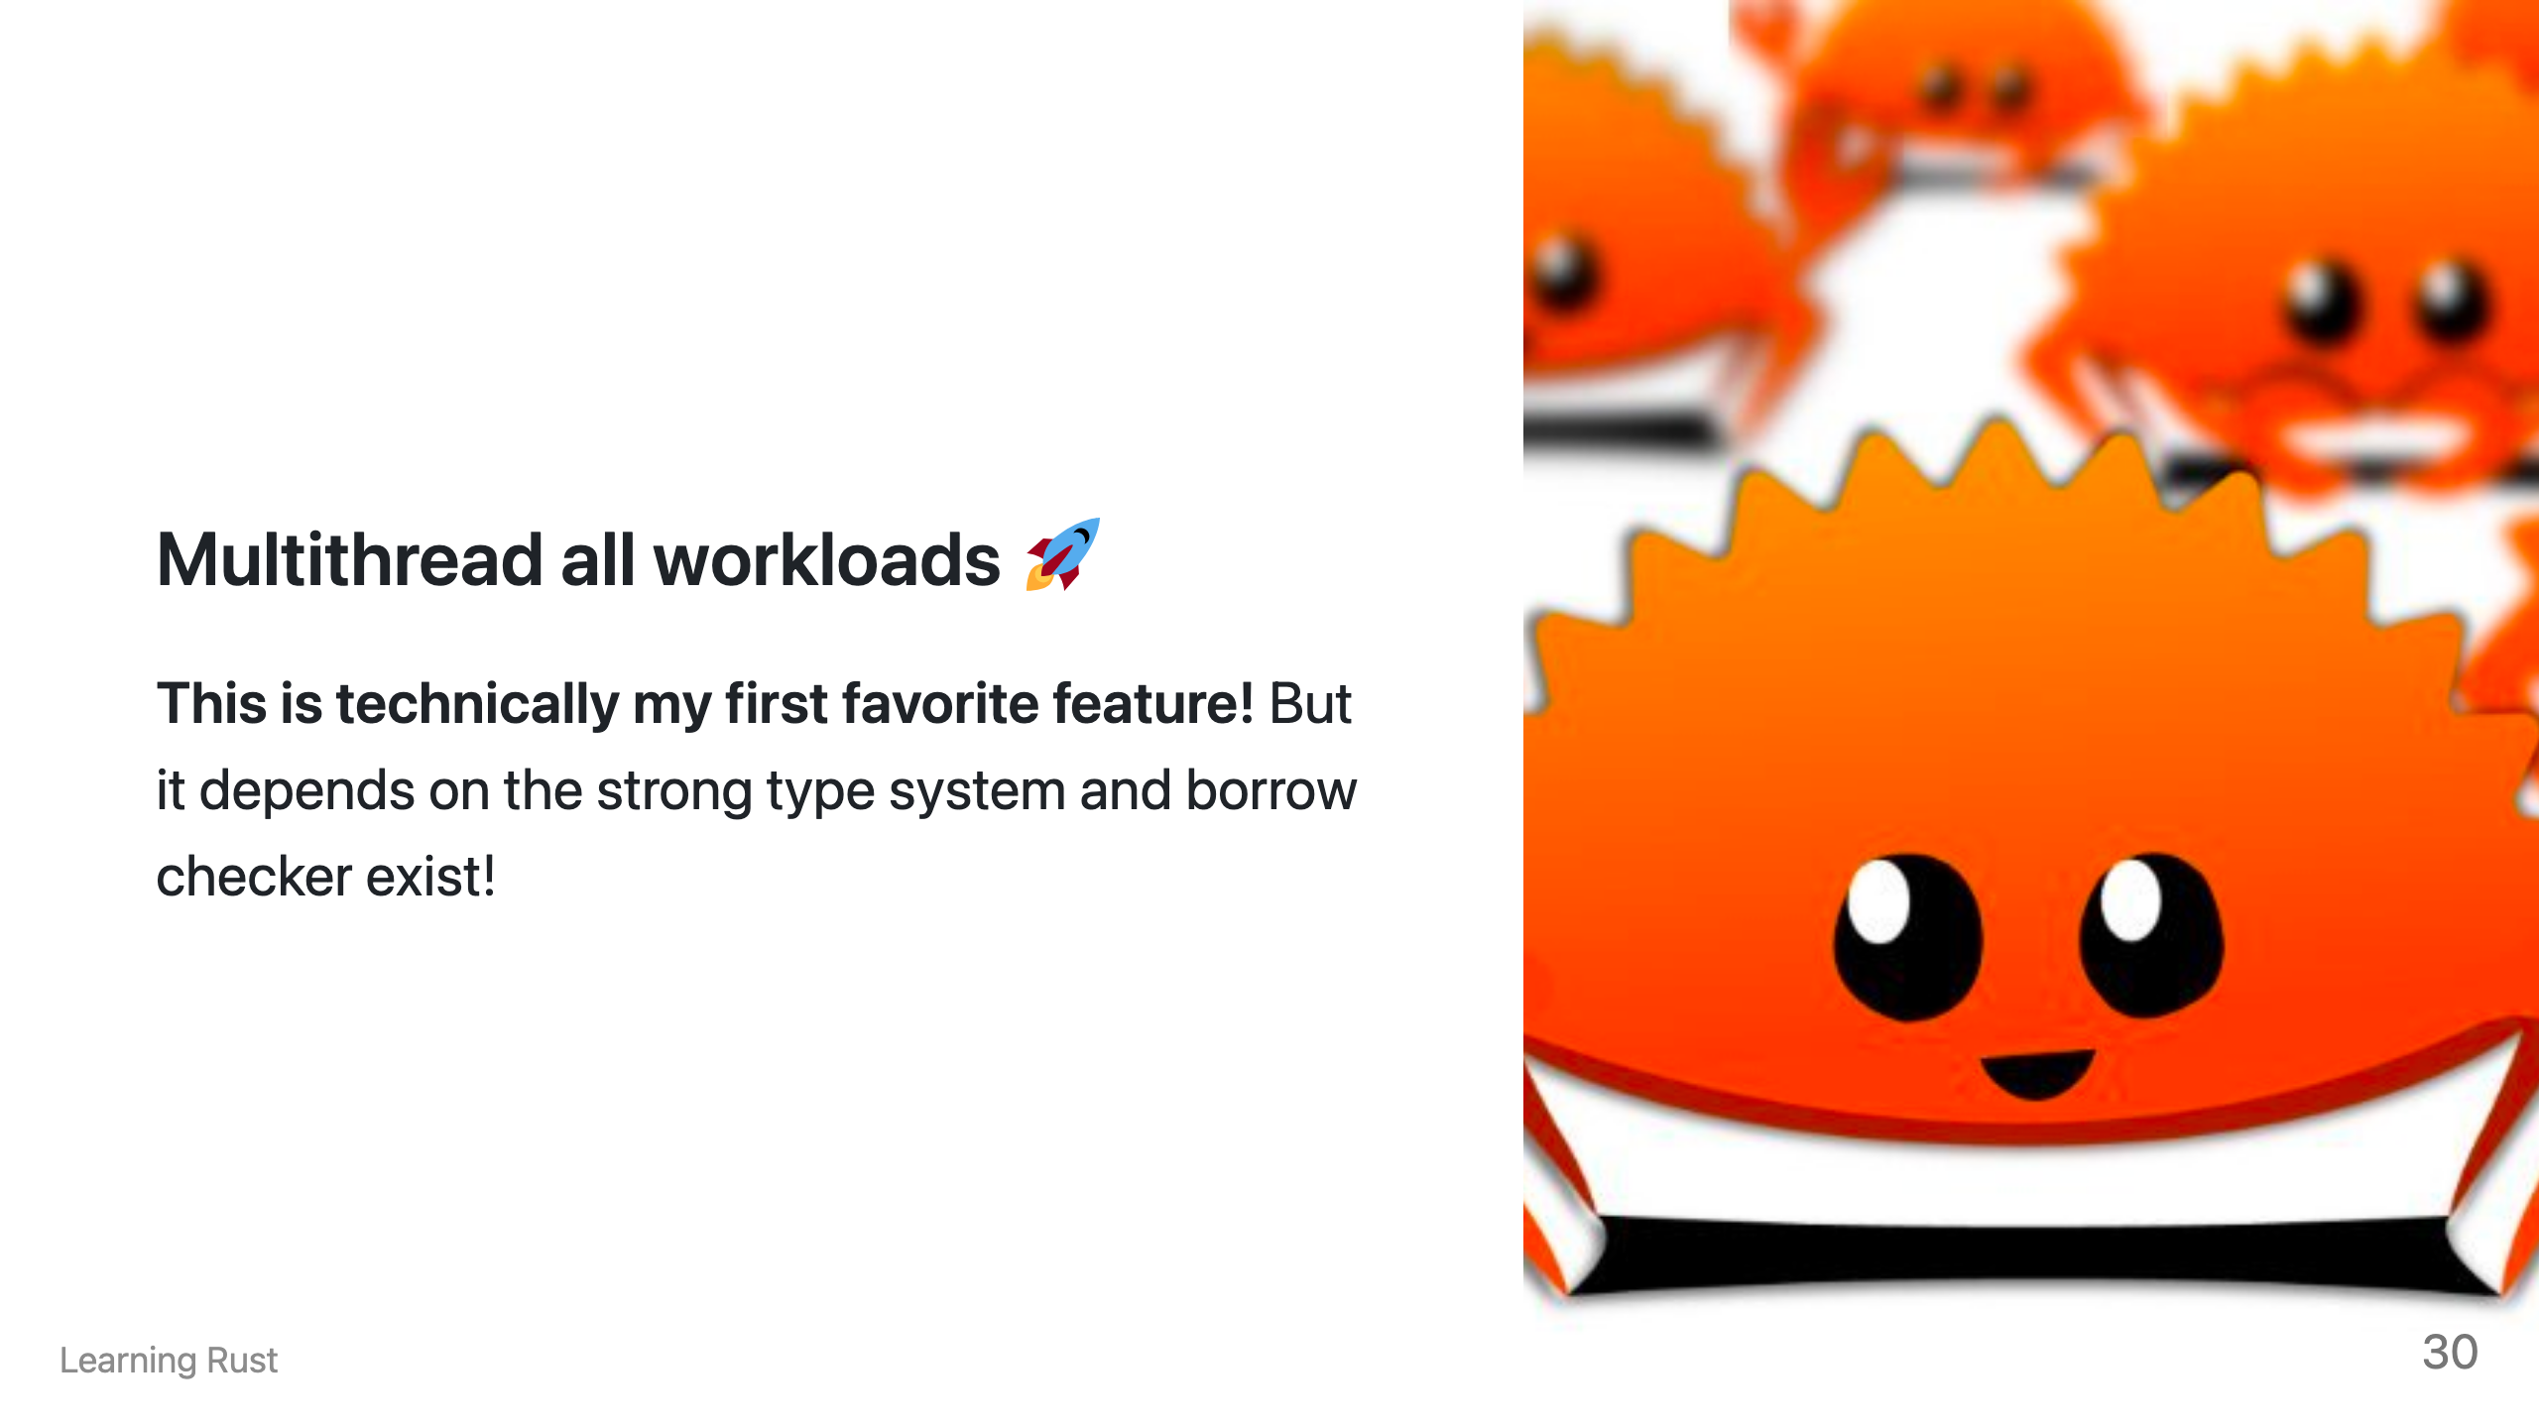
Notes:
Highlight the Benefits for Programmers: Focus on Safety: Emphasize how fear of concurrency-related bugs disappears with Rust's built-in guarantees. Mention reduced debugging time and stress from knowing your code is thread-safe by default. Reduce Boilerplate: Show how Rust avoids complex locking code and thread management, leading to concise and readable concurrency constructs. Compare the simpler syntax of channels and message passing to manual primitives in other languages. Increased Performance: Briefly mention the potential performance advantages of zero-cost abstractions and efficient memory management in Rust's concurrency system. Explain how avoiding unnecessary locking and data copying can contribute to faster applications.

Slide 32
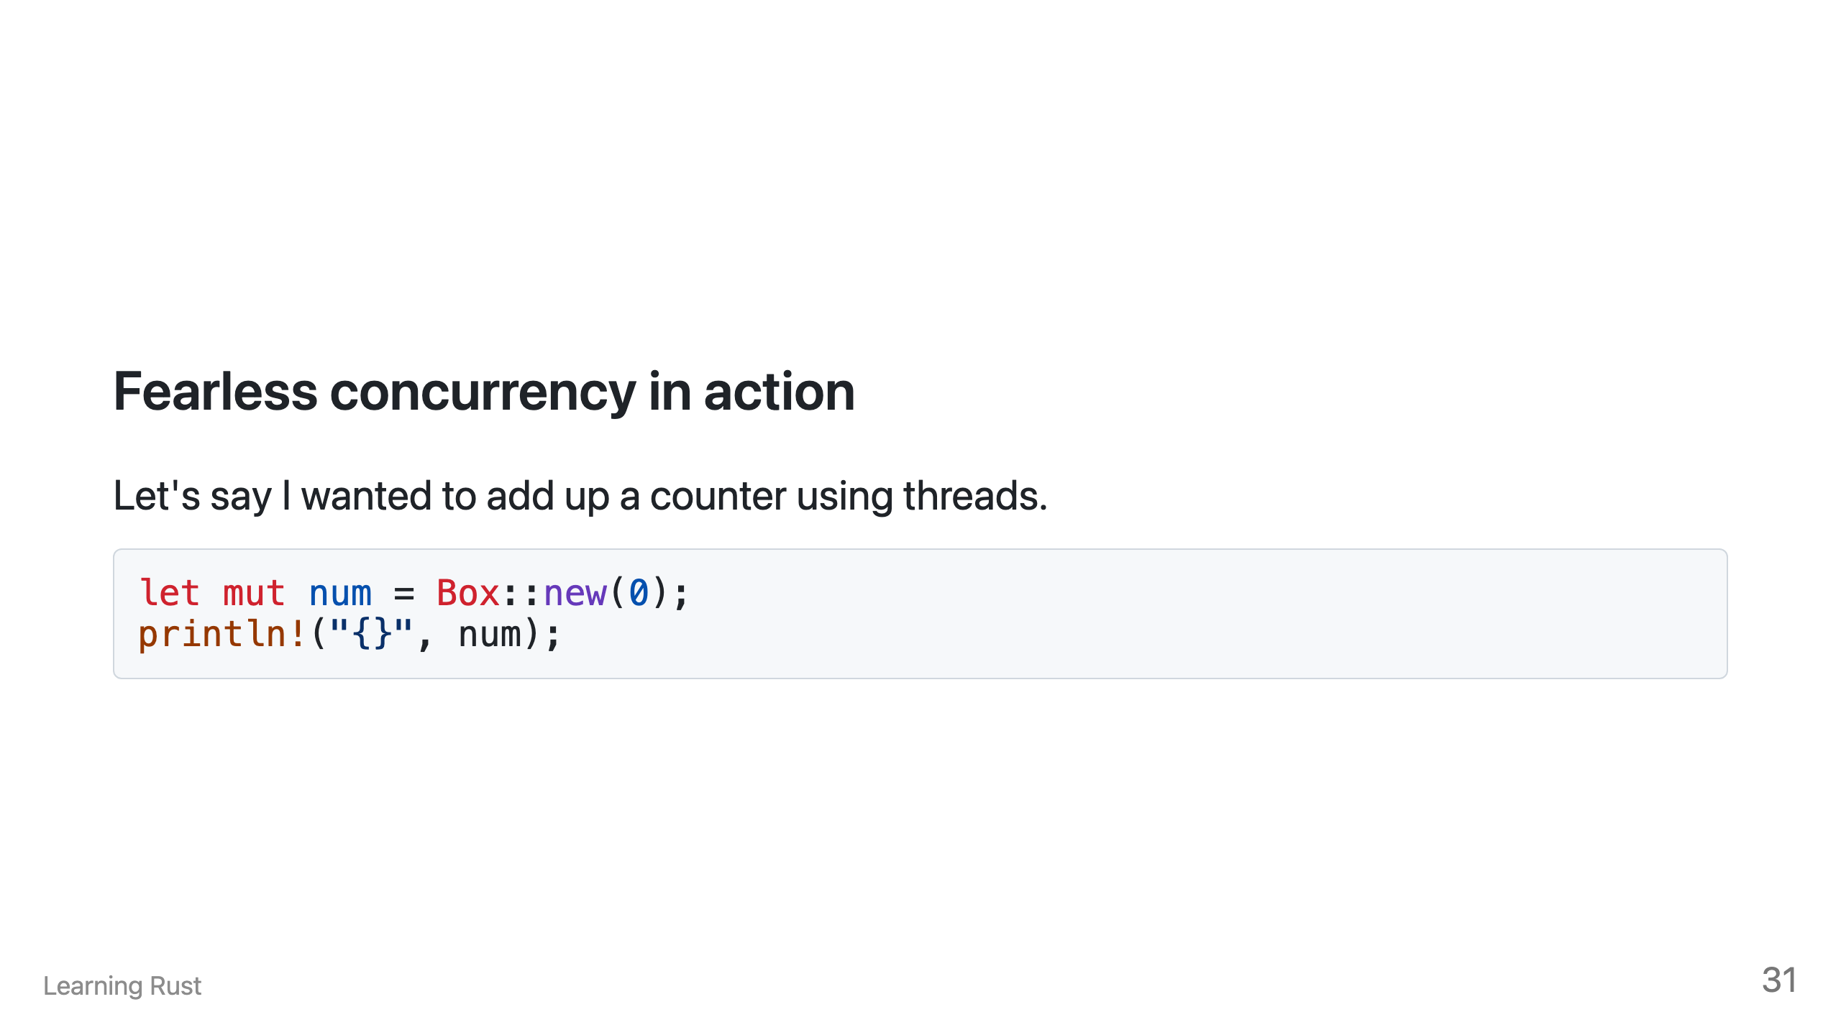

Slide 33
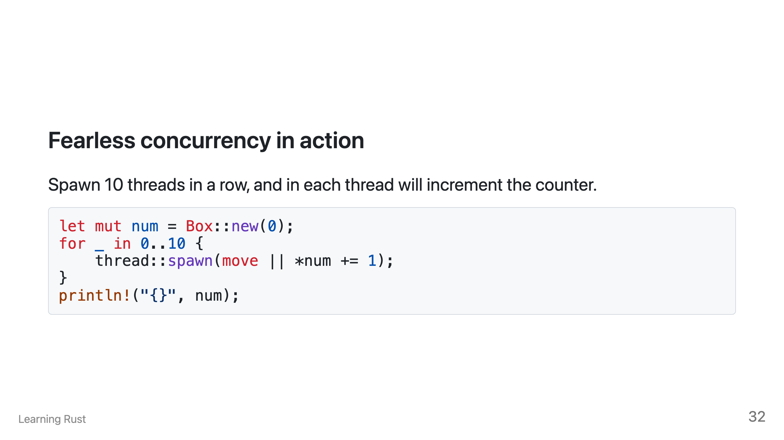

Slide 34
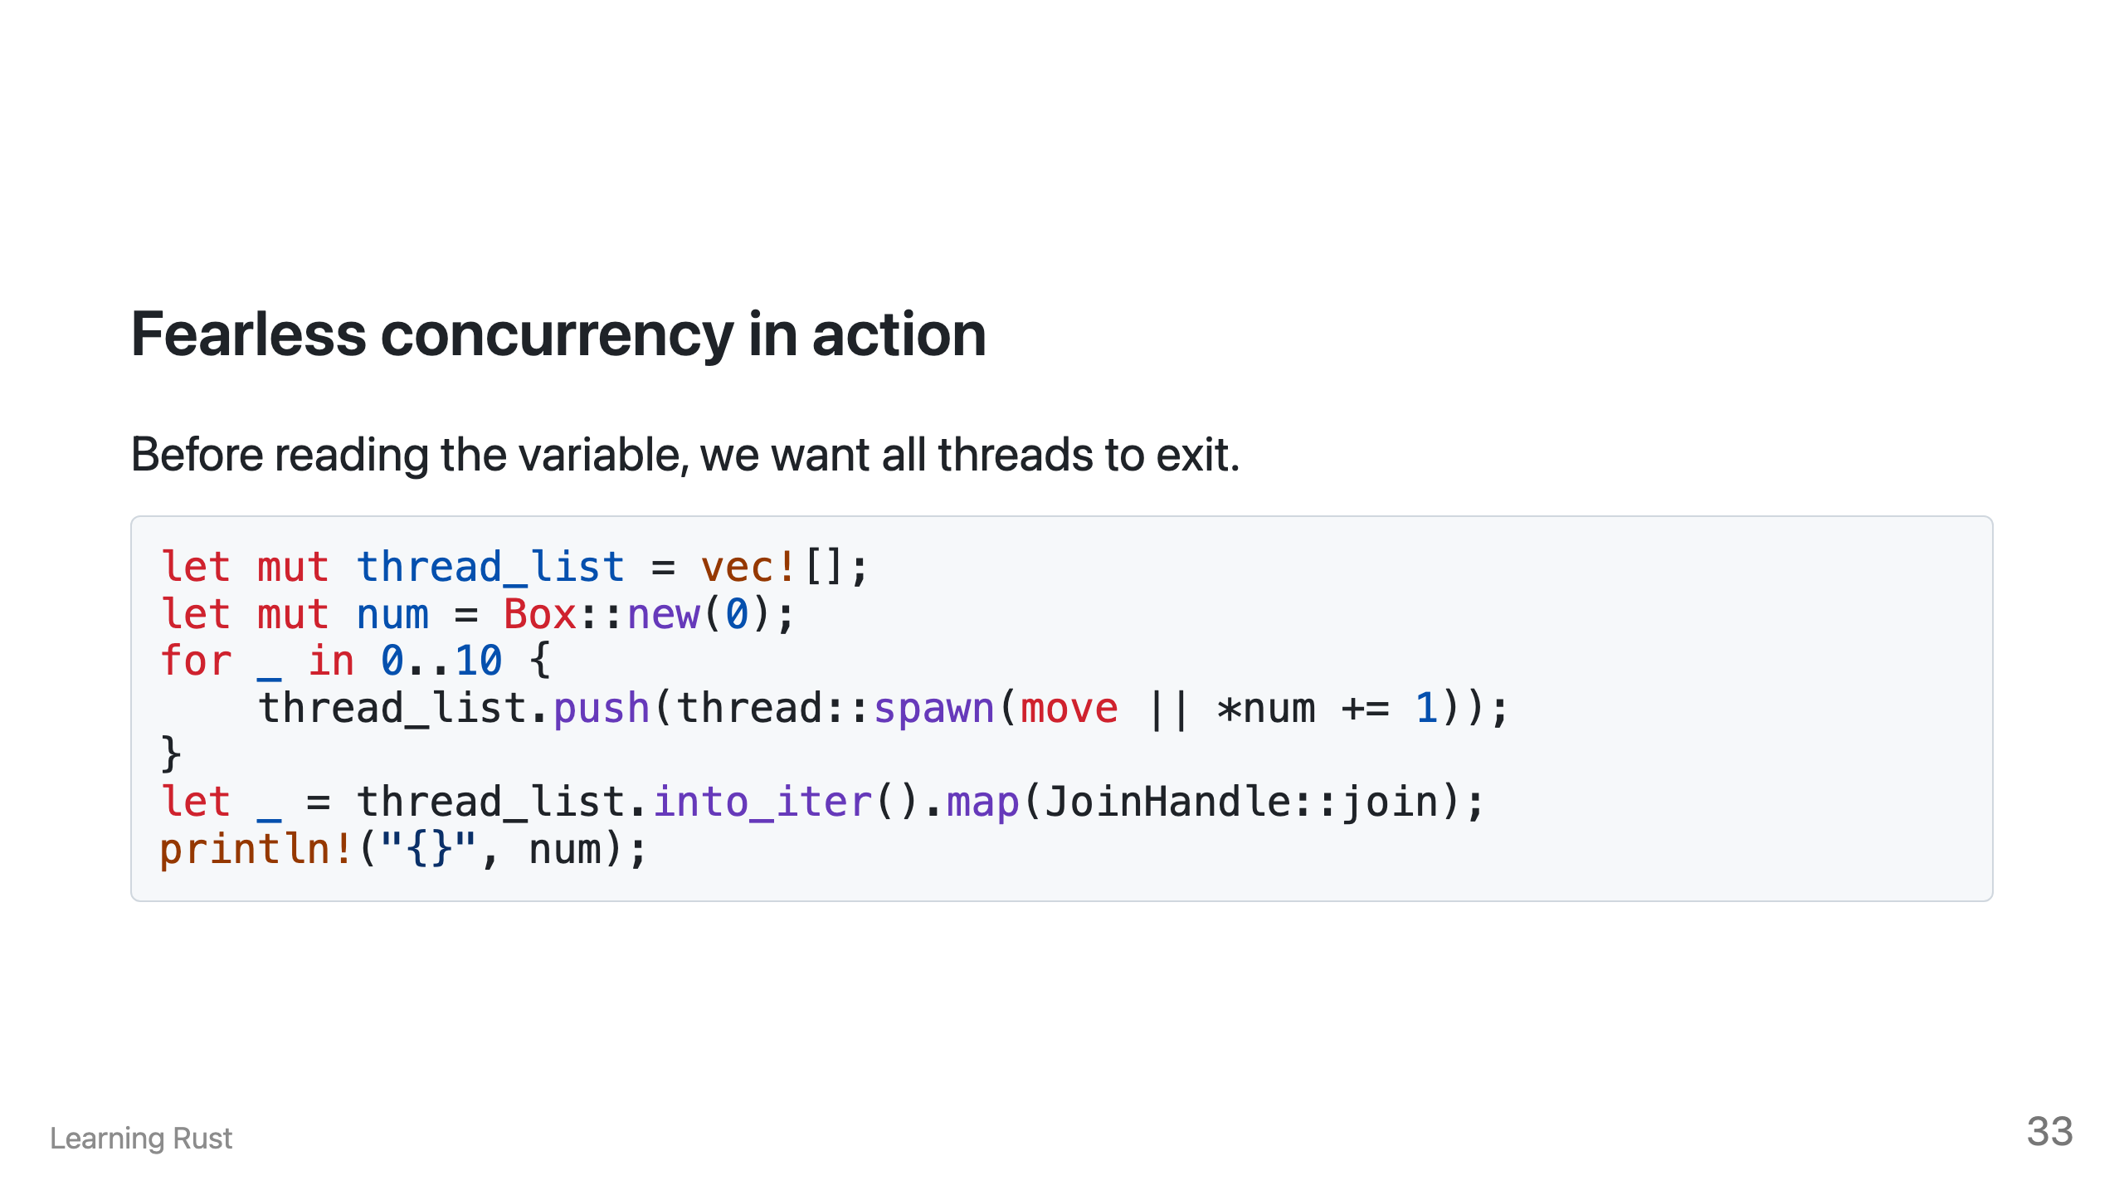

Slide 35
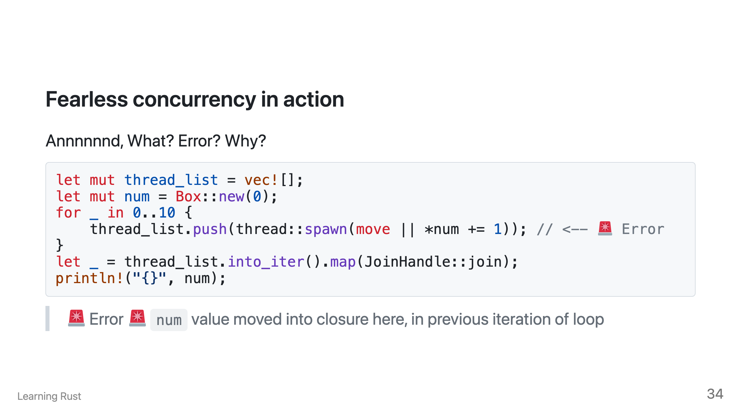

Slide 36
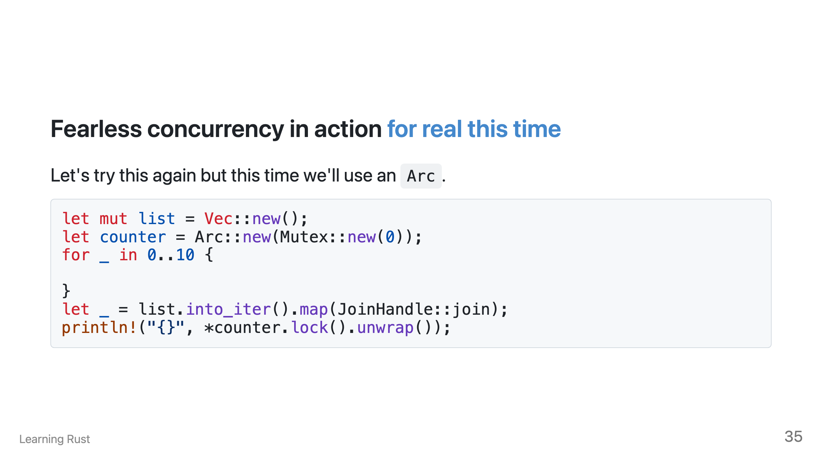

Slide 37
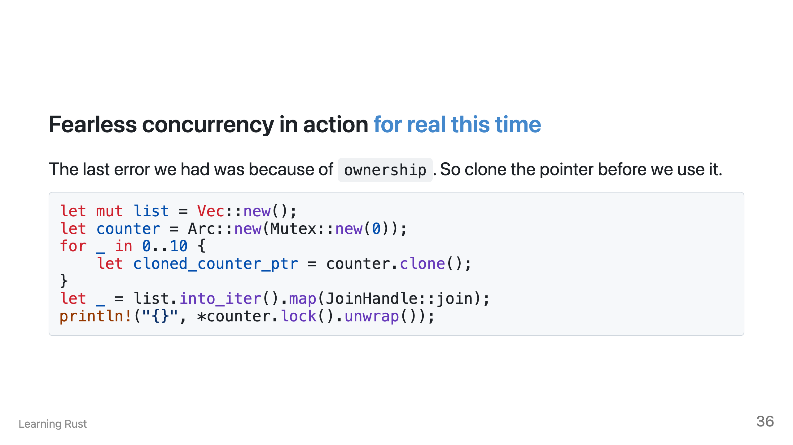

Slide 38
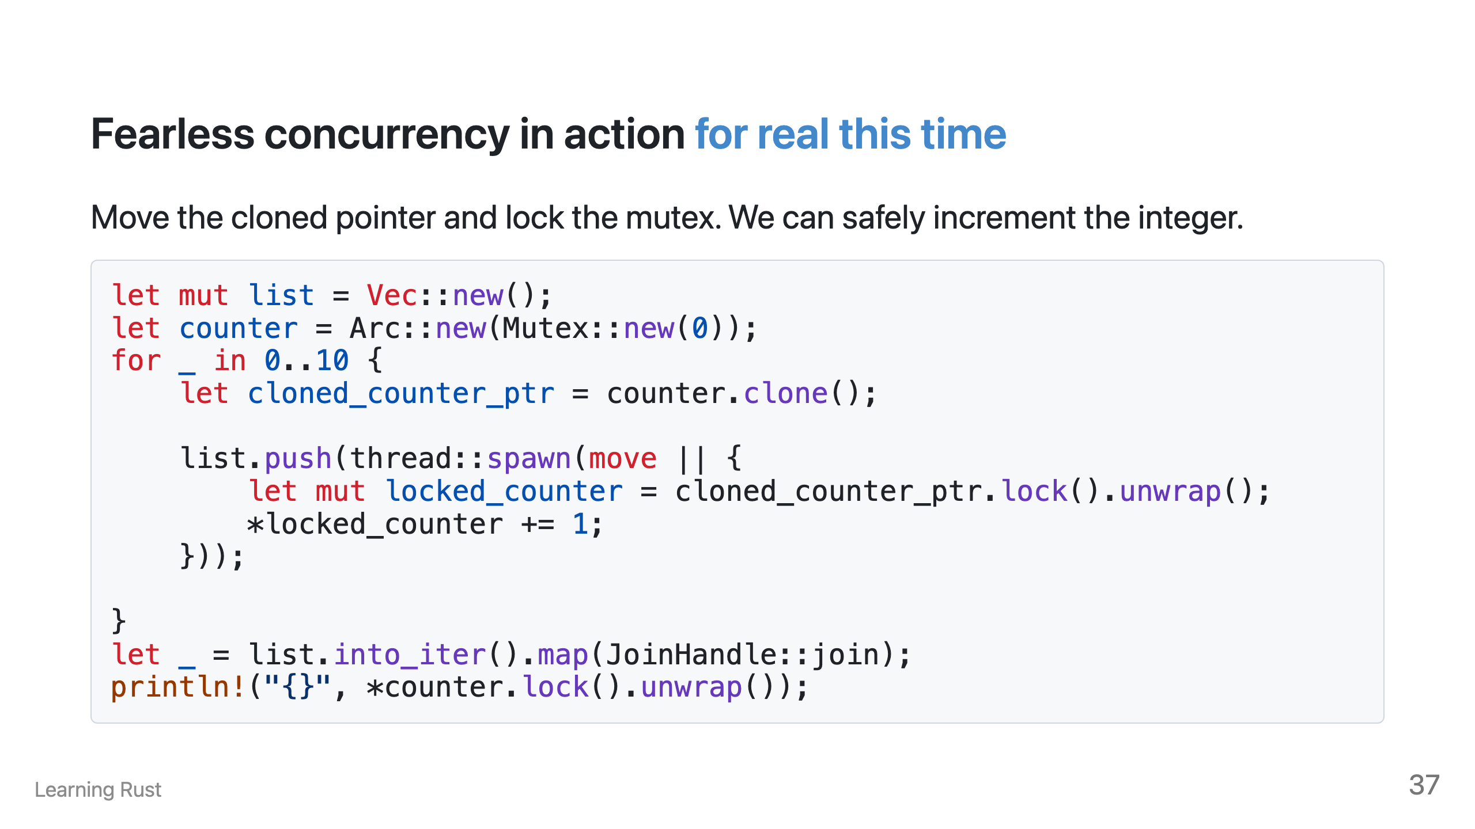

Slide 39
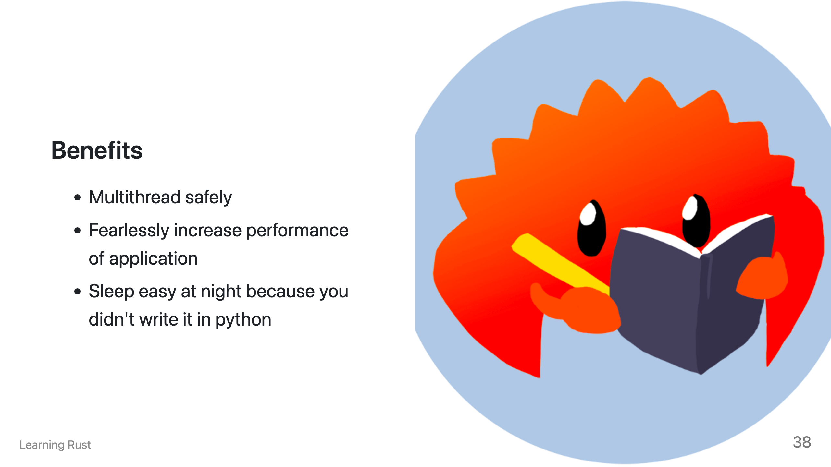
Notes:
By relying on the borrow checker, we can scale our code to use the full potential of our CPU without being scared we are programming data races into our code. We can fearlessly distribute our work across multiple threads and reap the increased performance in our application. Sleep easy knowing that when a Rust program compiles, it's means that 99% of the time, it will work exactly the way you expect and won't wake you up at 1AM.

Slide 40


Slide 41
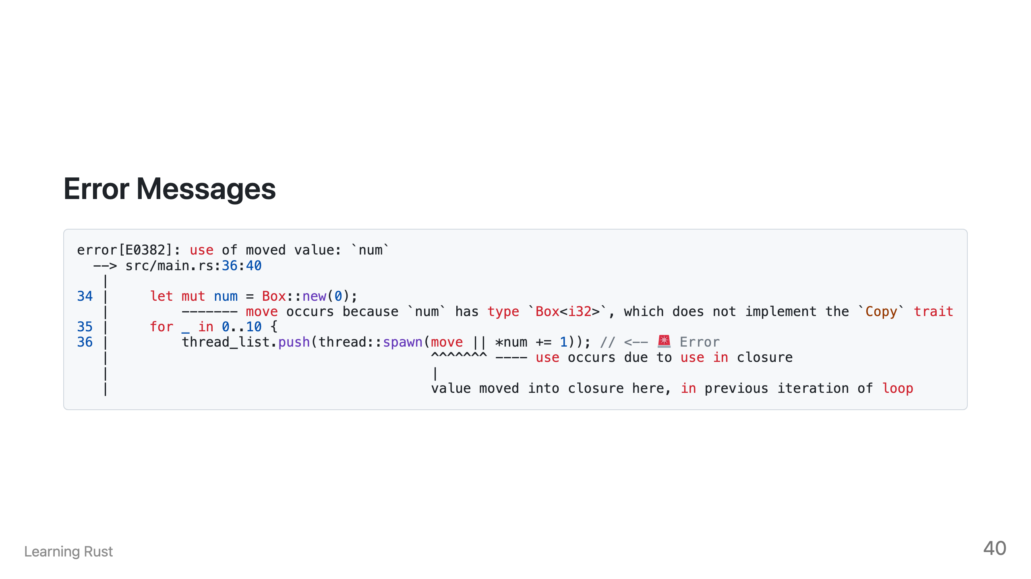

Slide 42
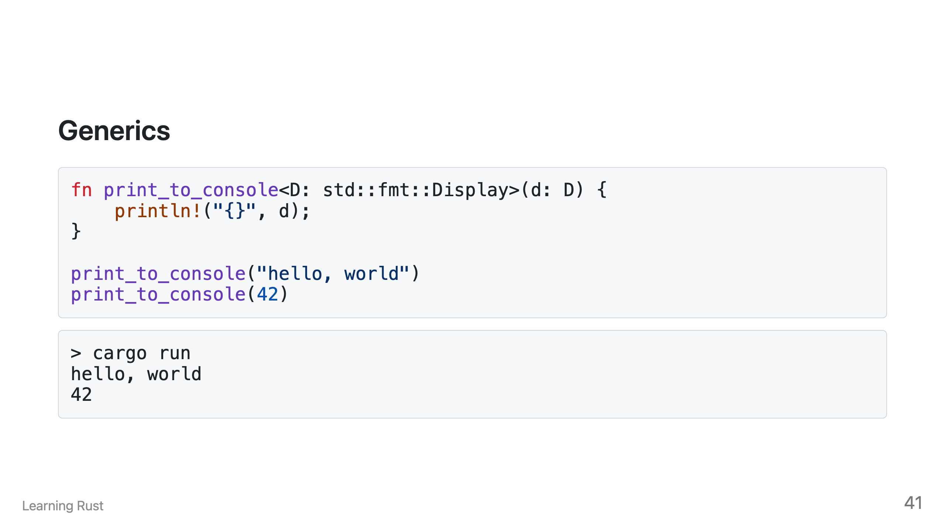

Slide 43
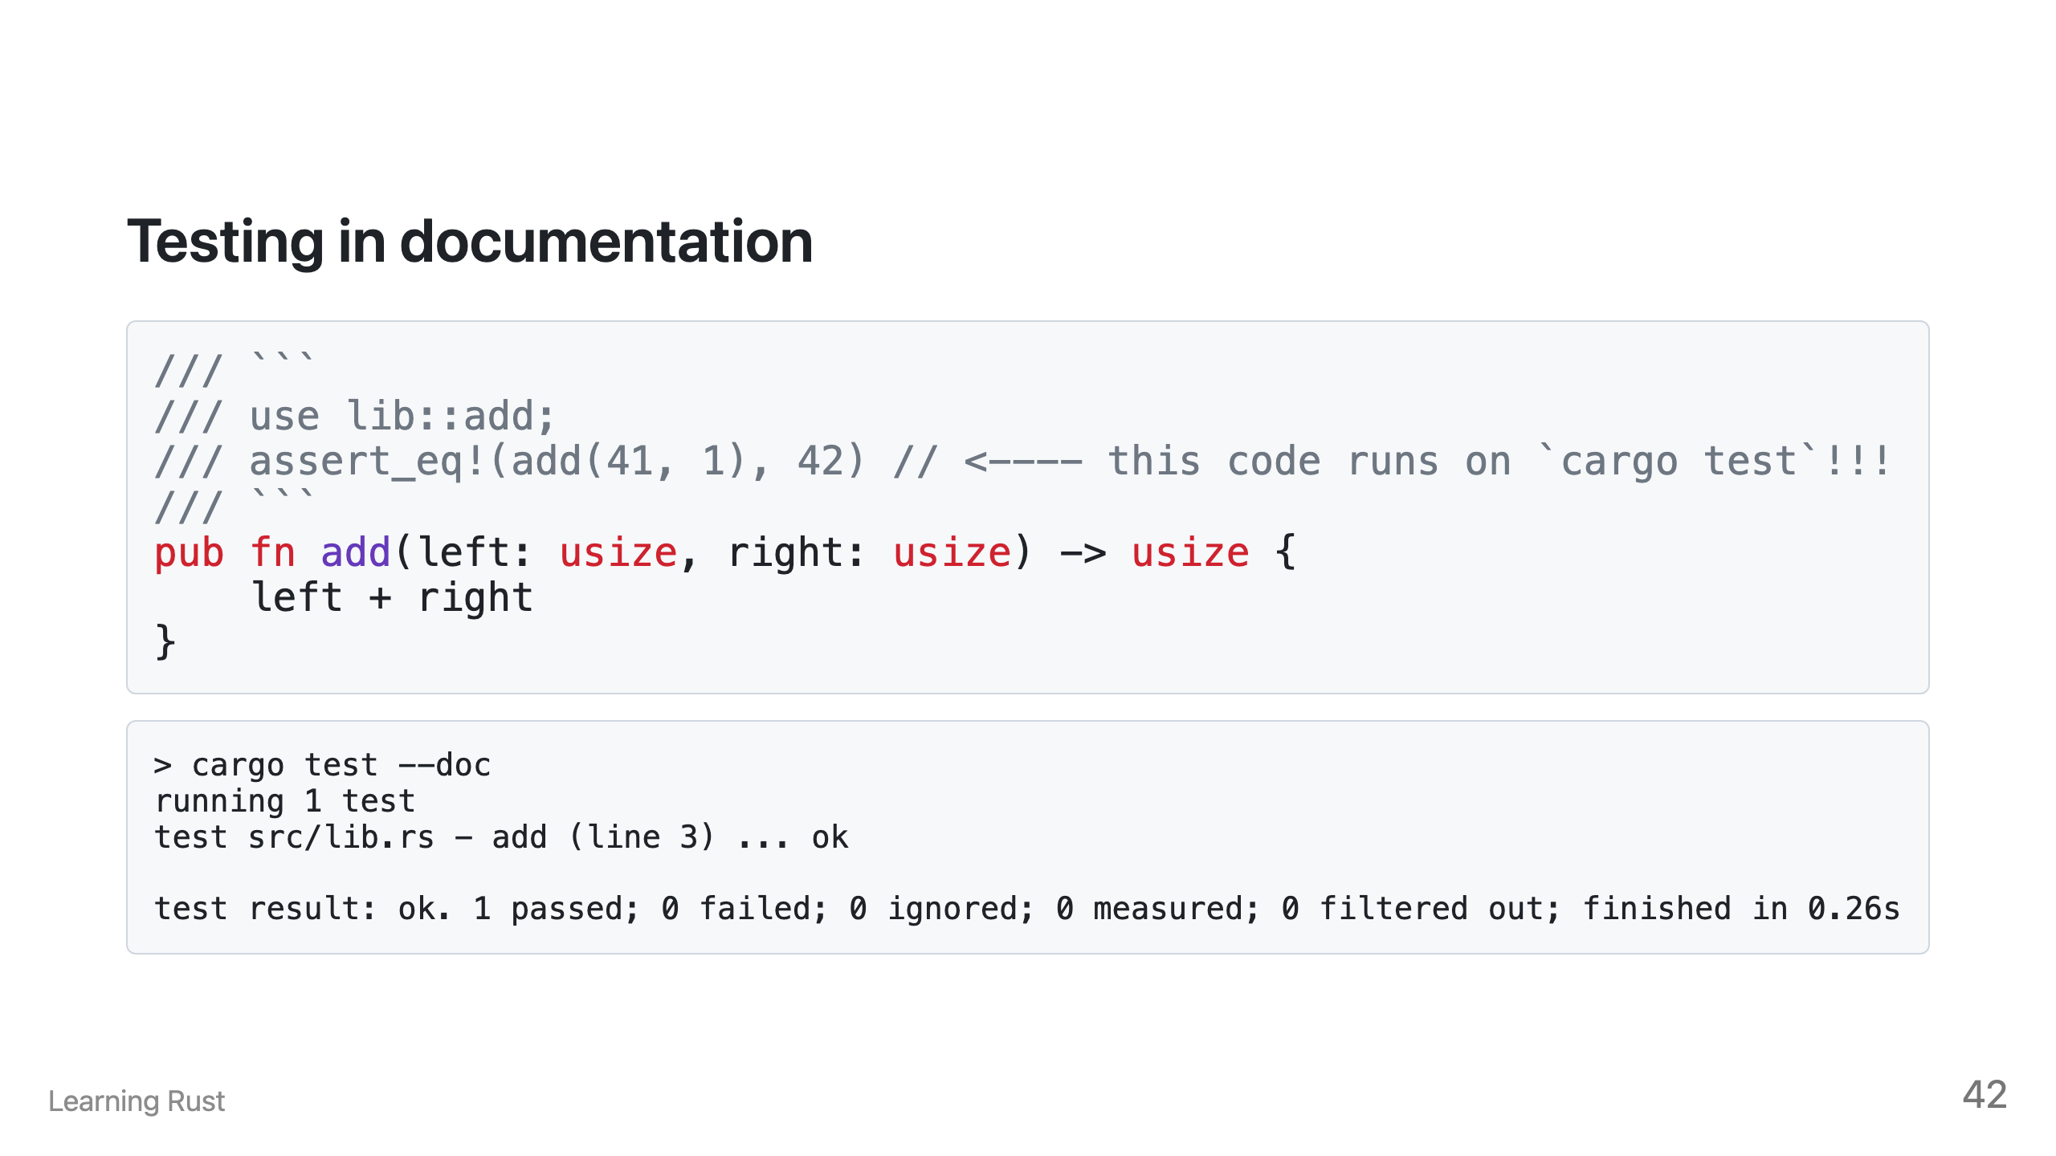

Slide 44
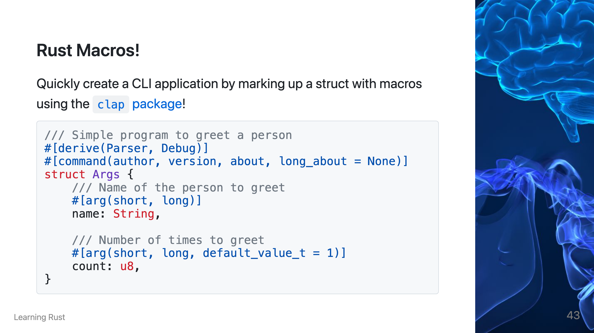

Slide 45
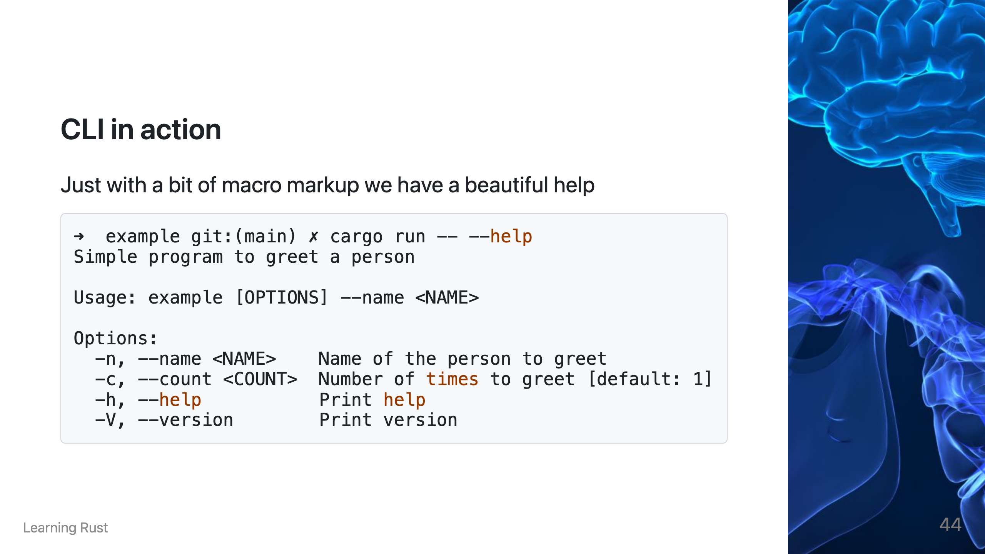

Slide 46
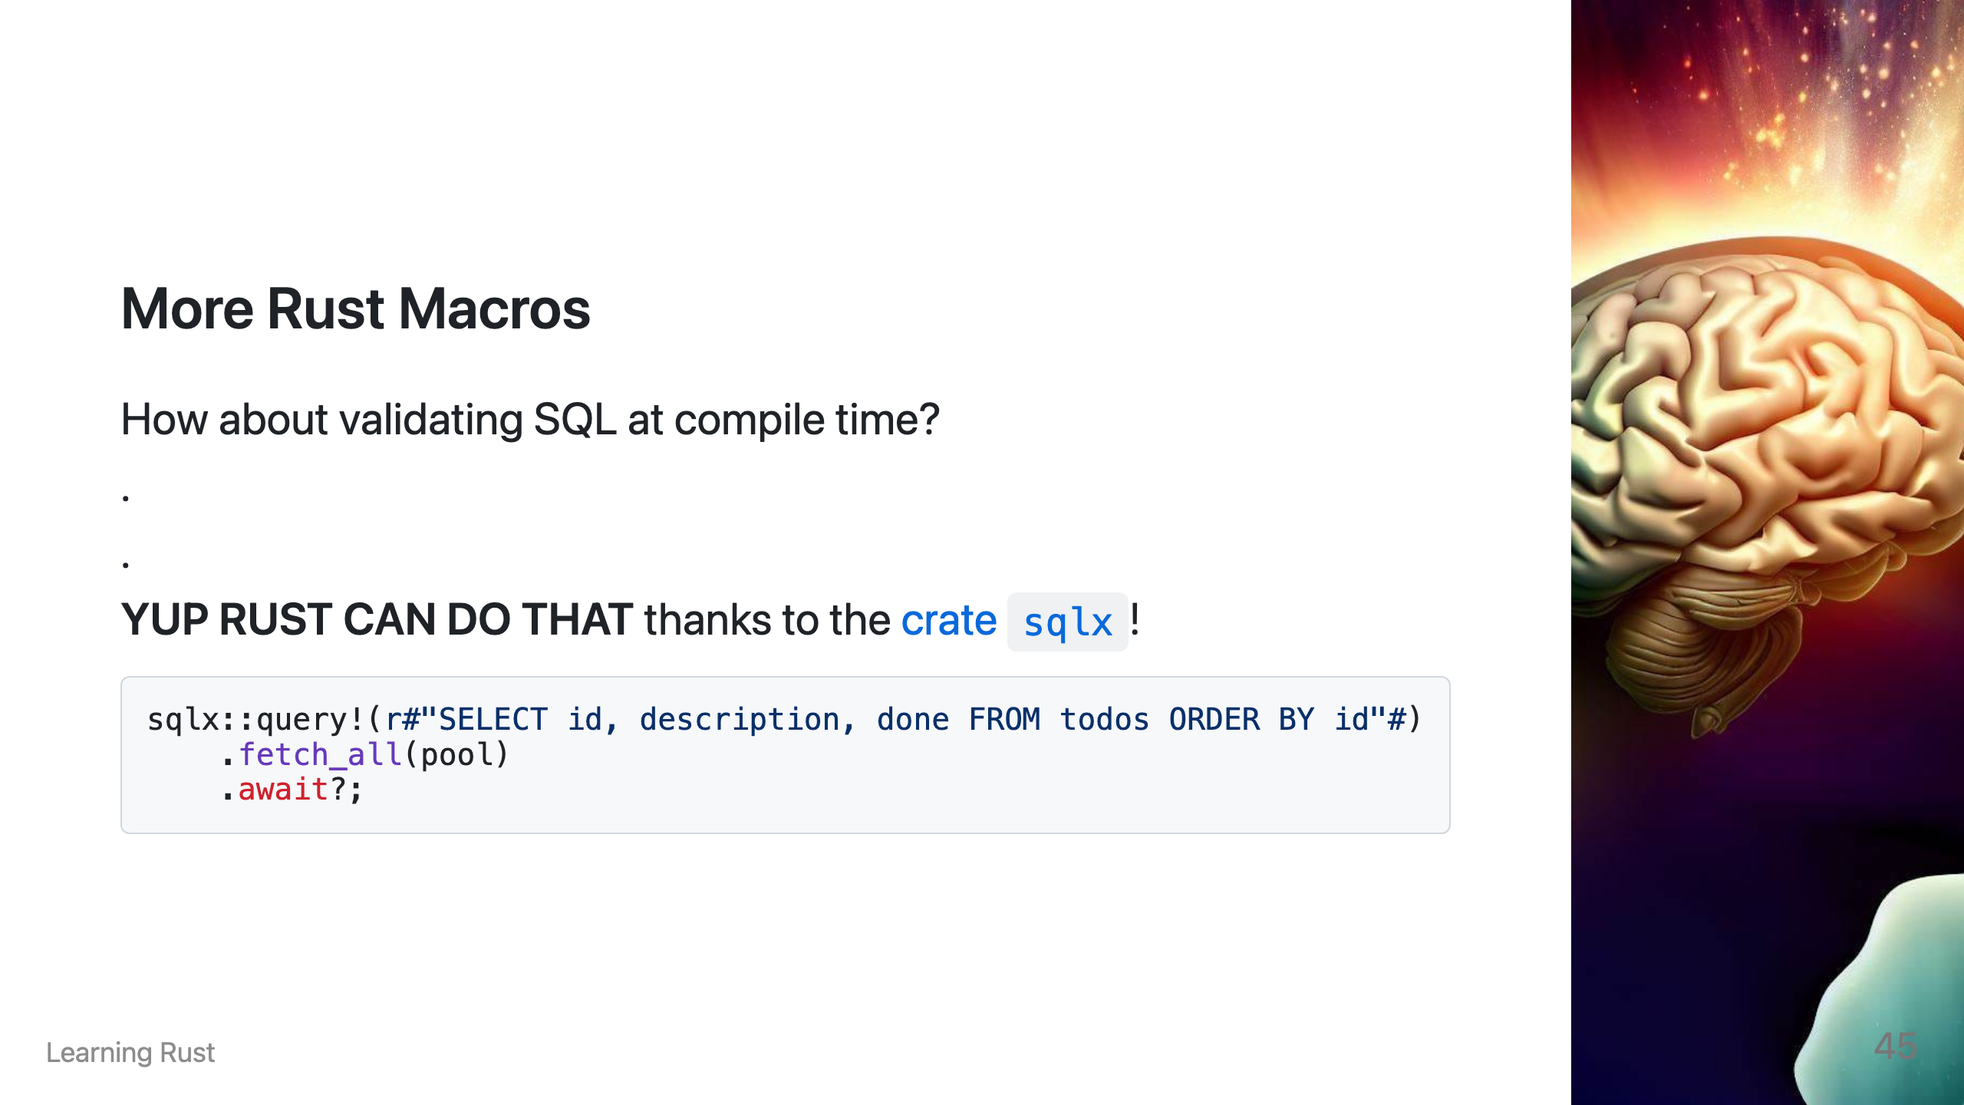

Slide 47
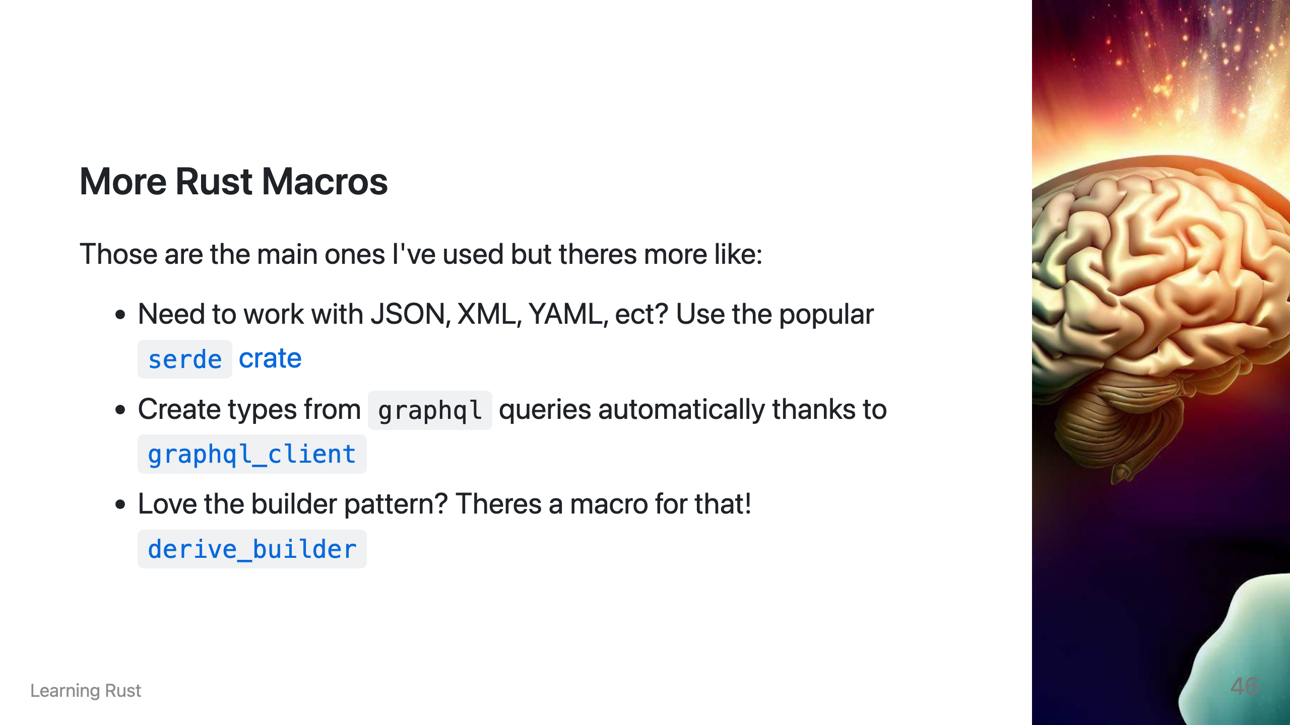

Slide 48
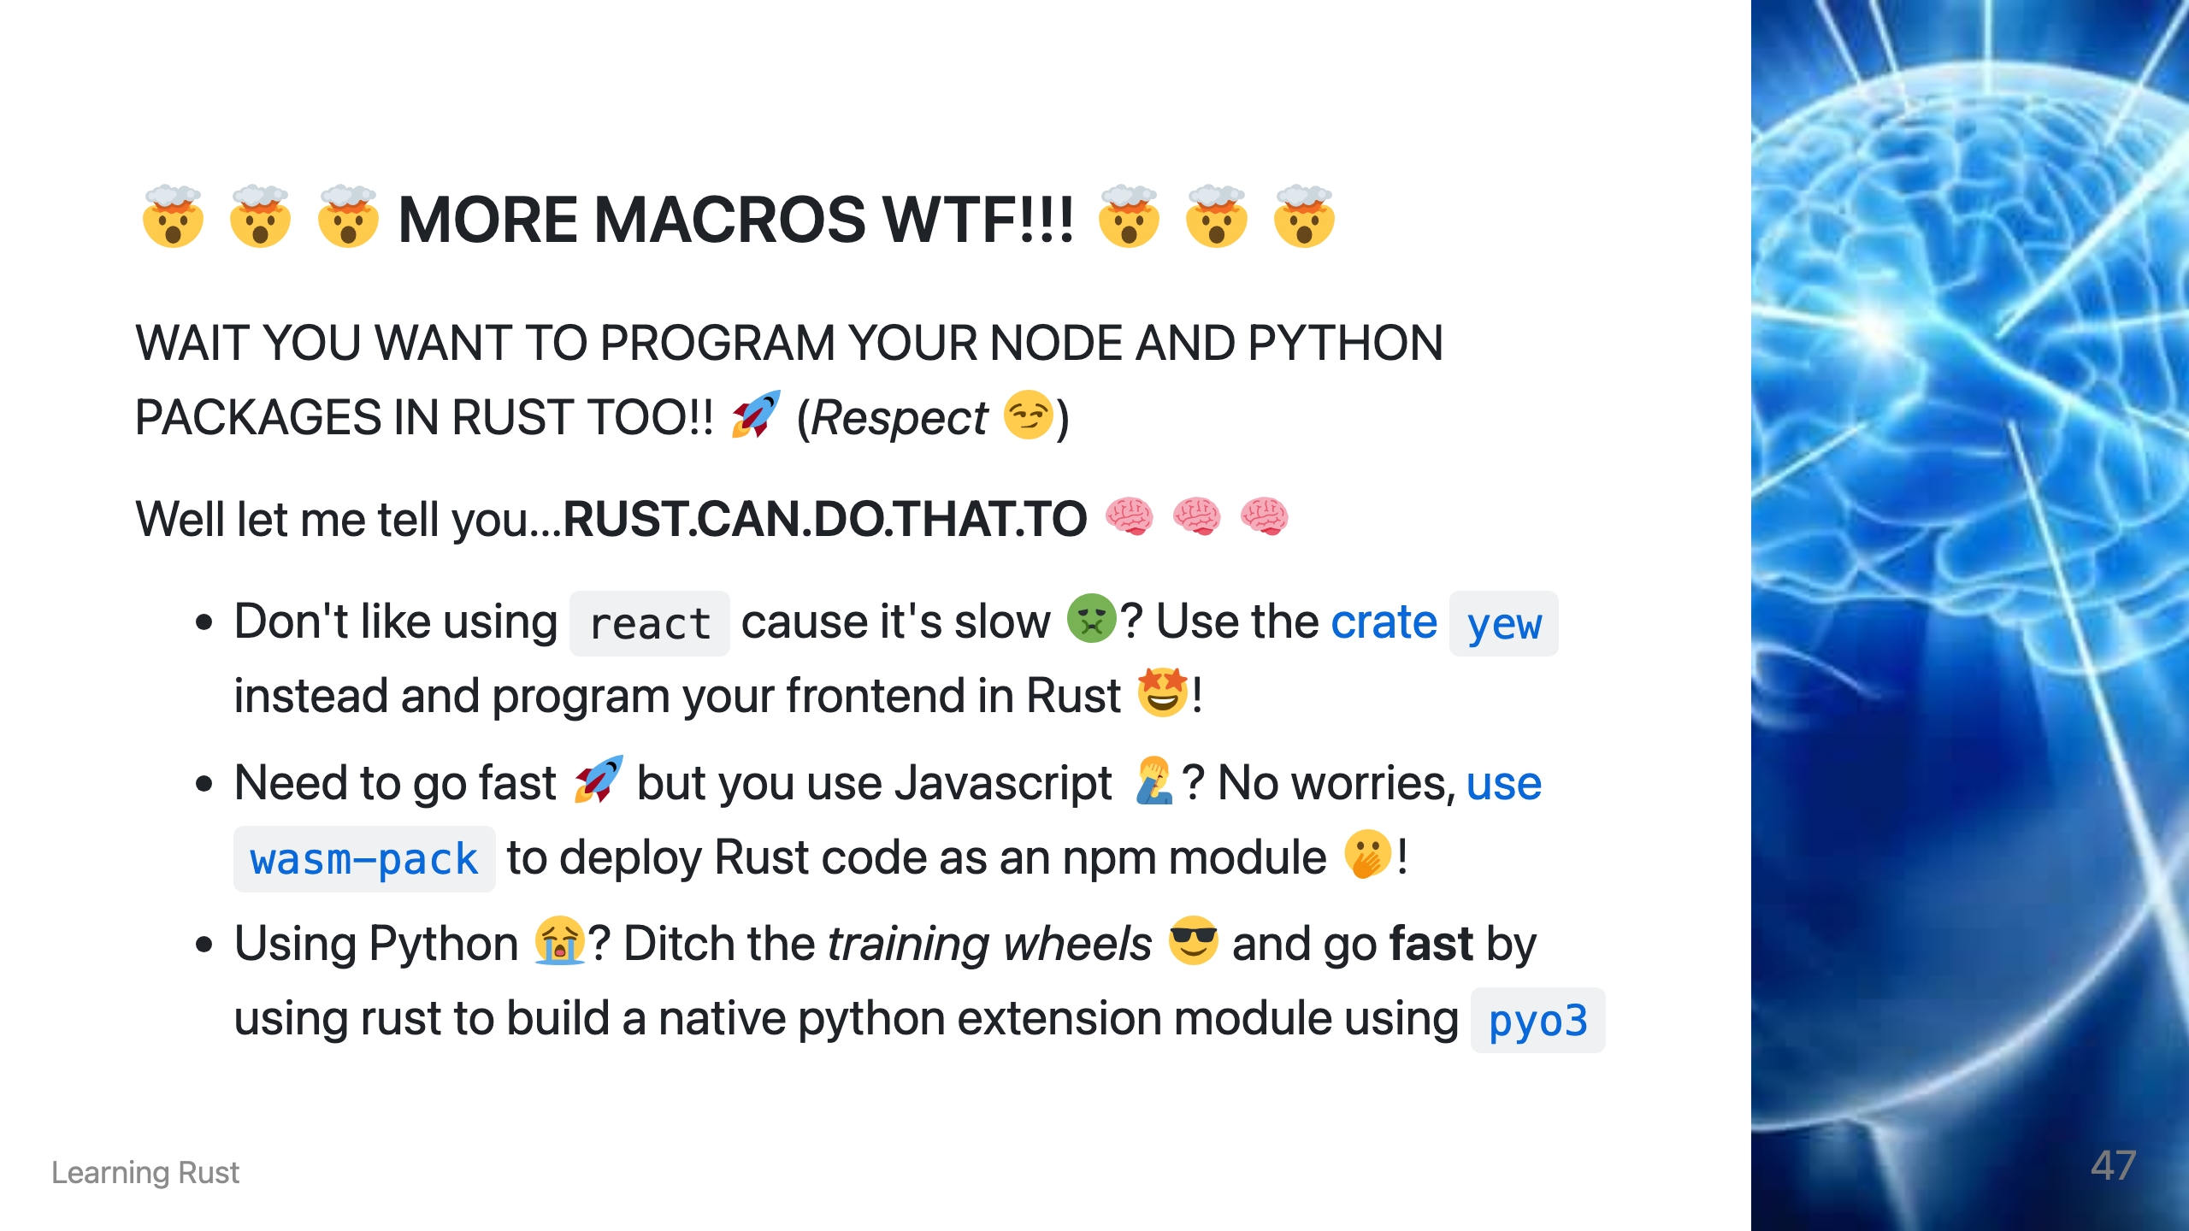

Slide 49
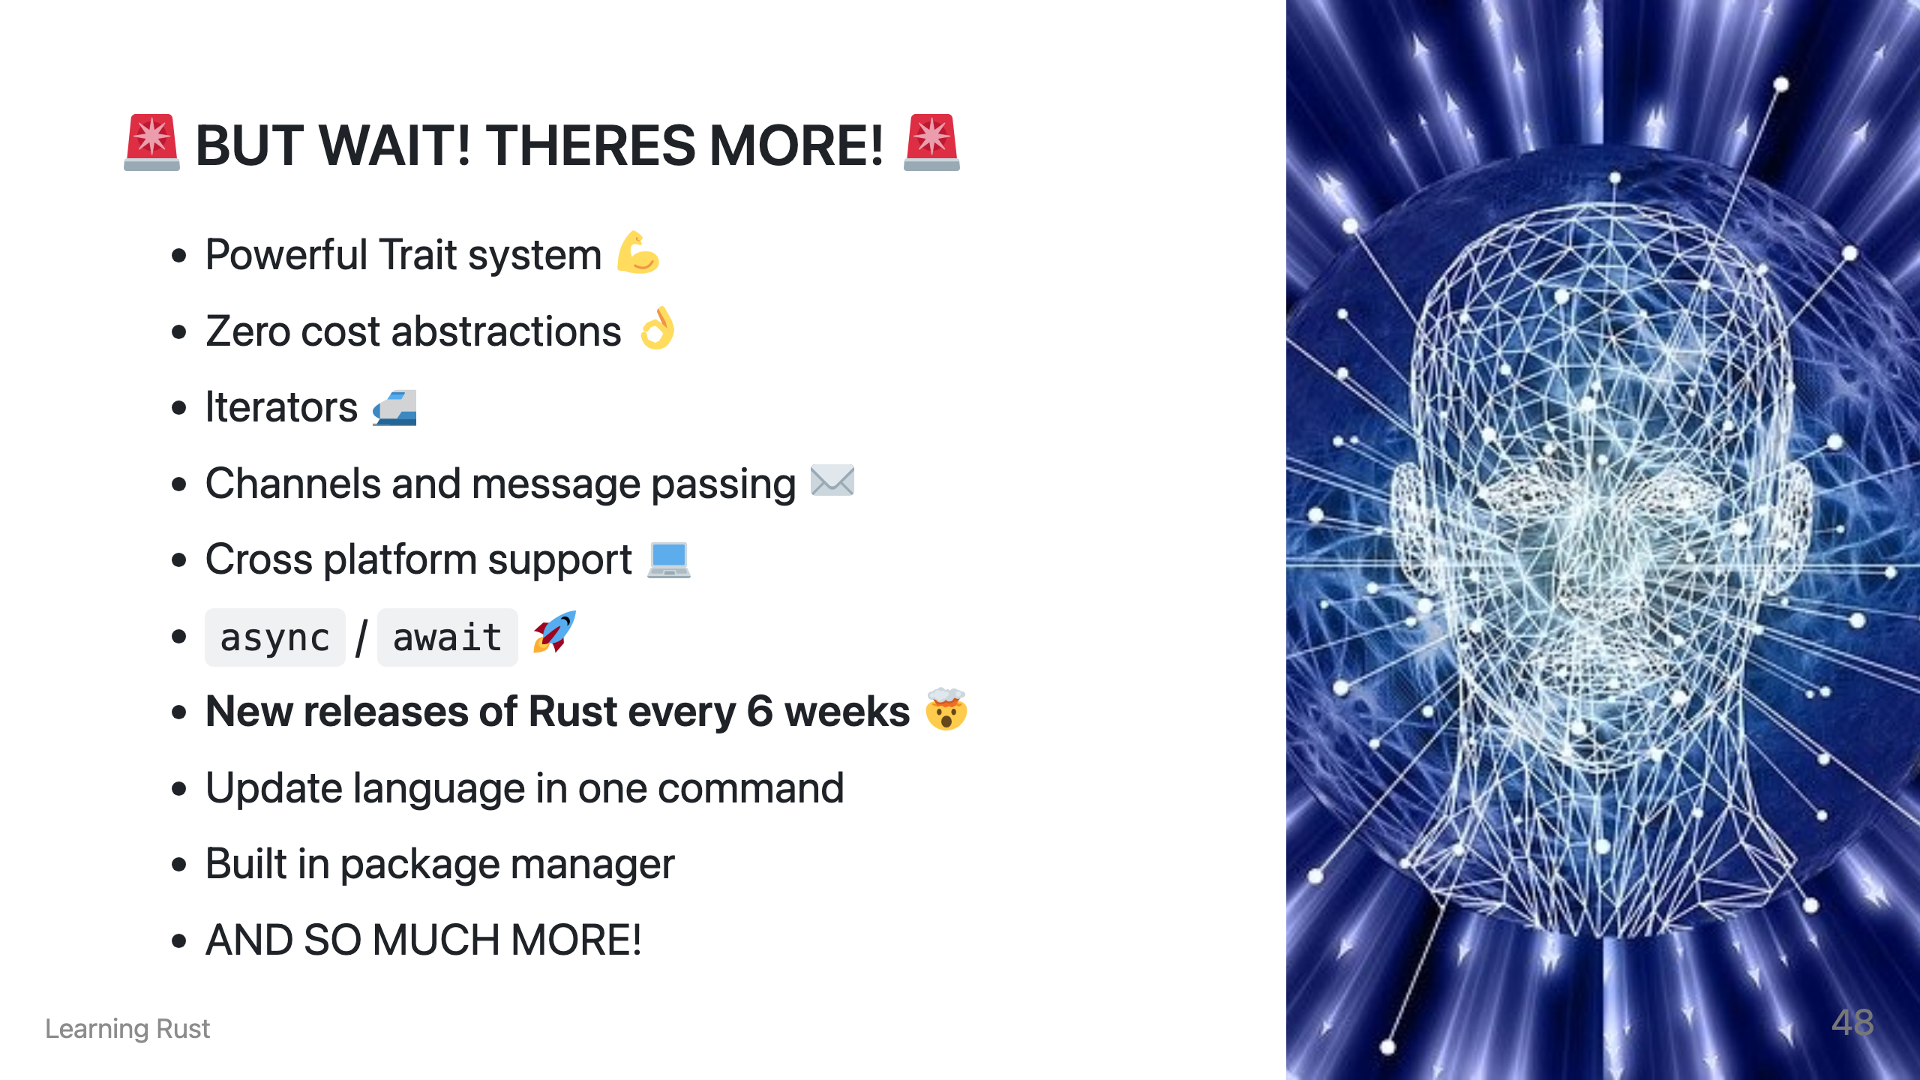

Slide 50
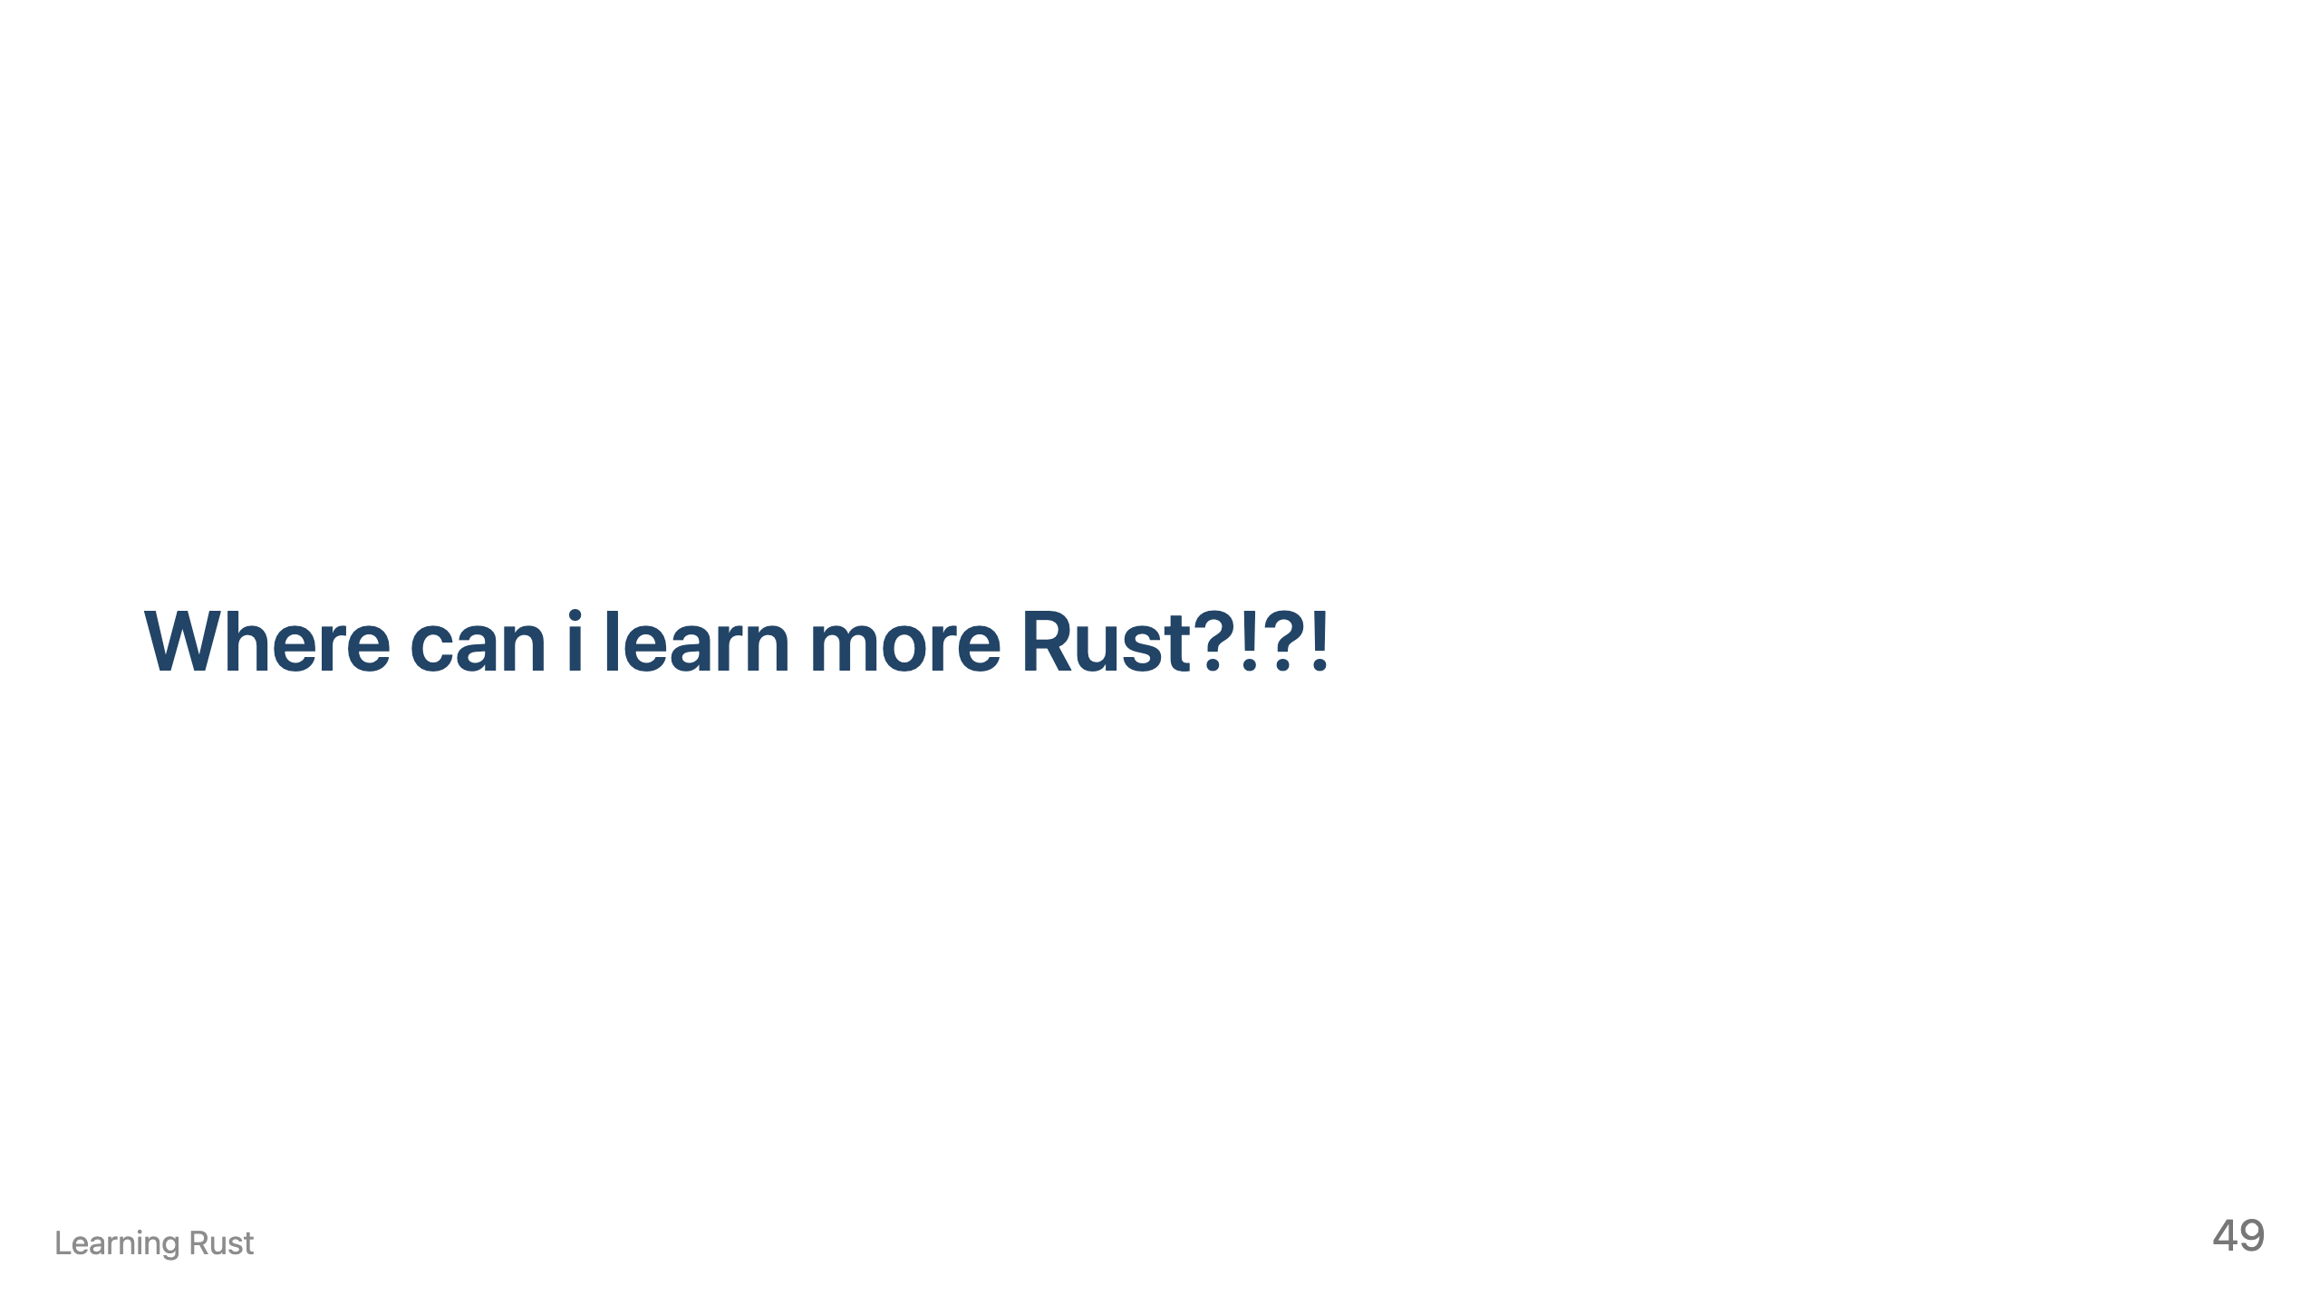

Slide 51
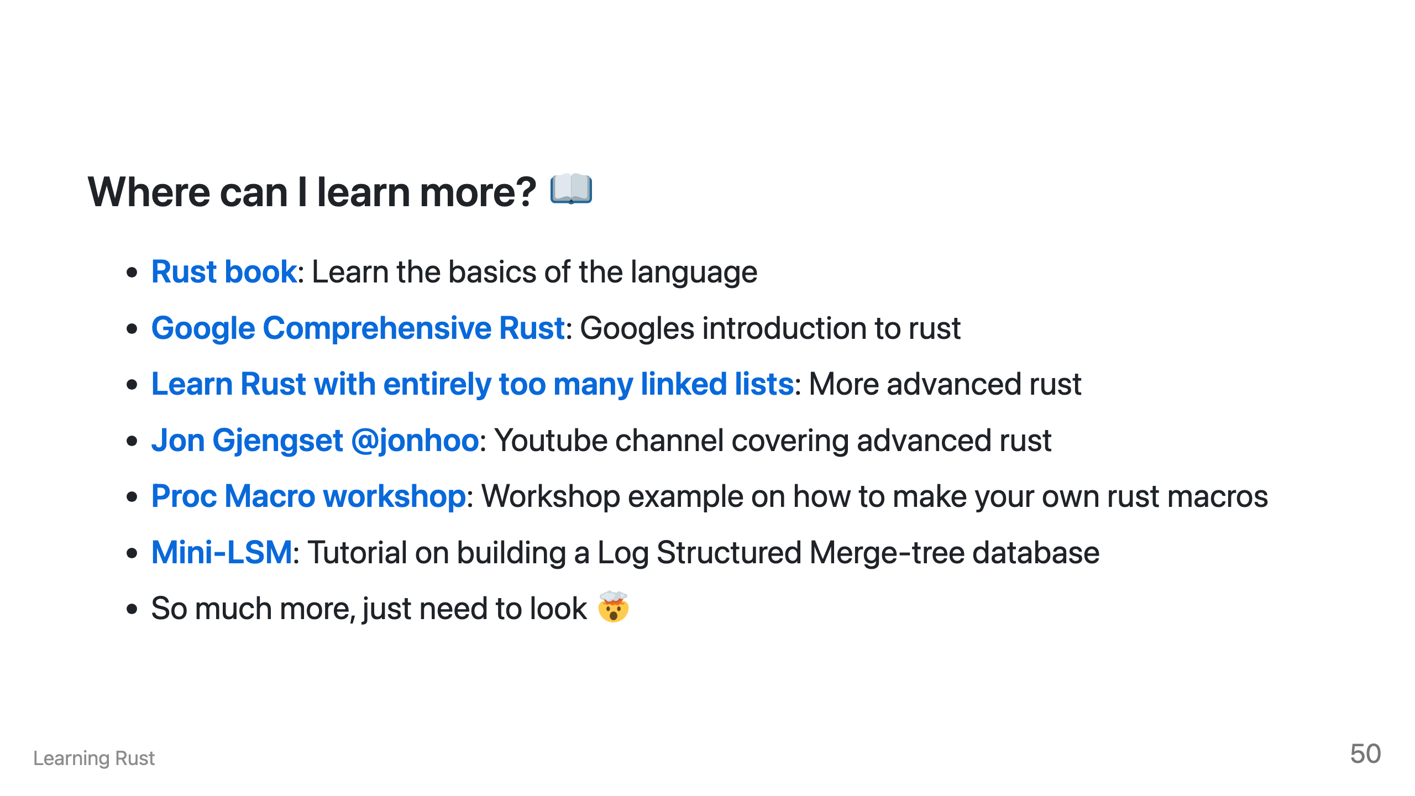
Notes:
I understand if this presentation has made you interested in learning why Rust is such a loved language. To help support you on this journey, Try and review the following:

Slide 52
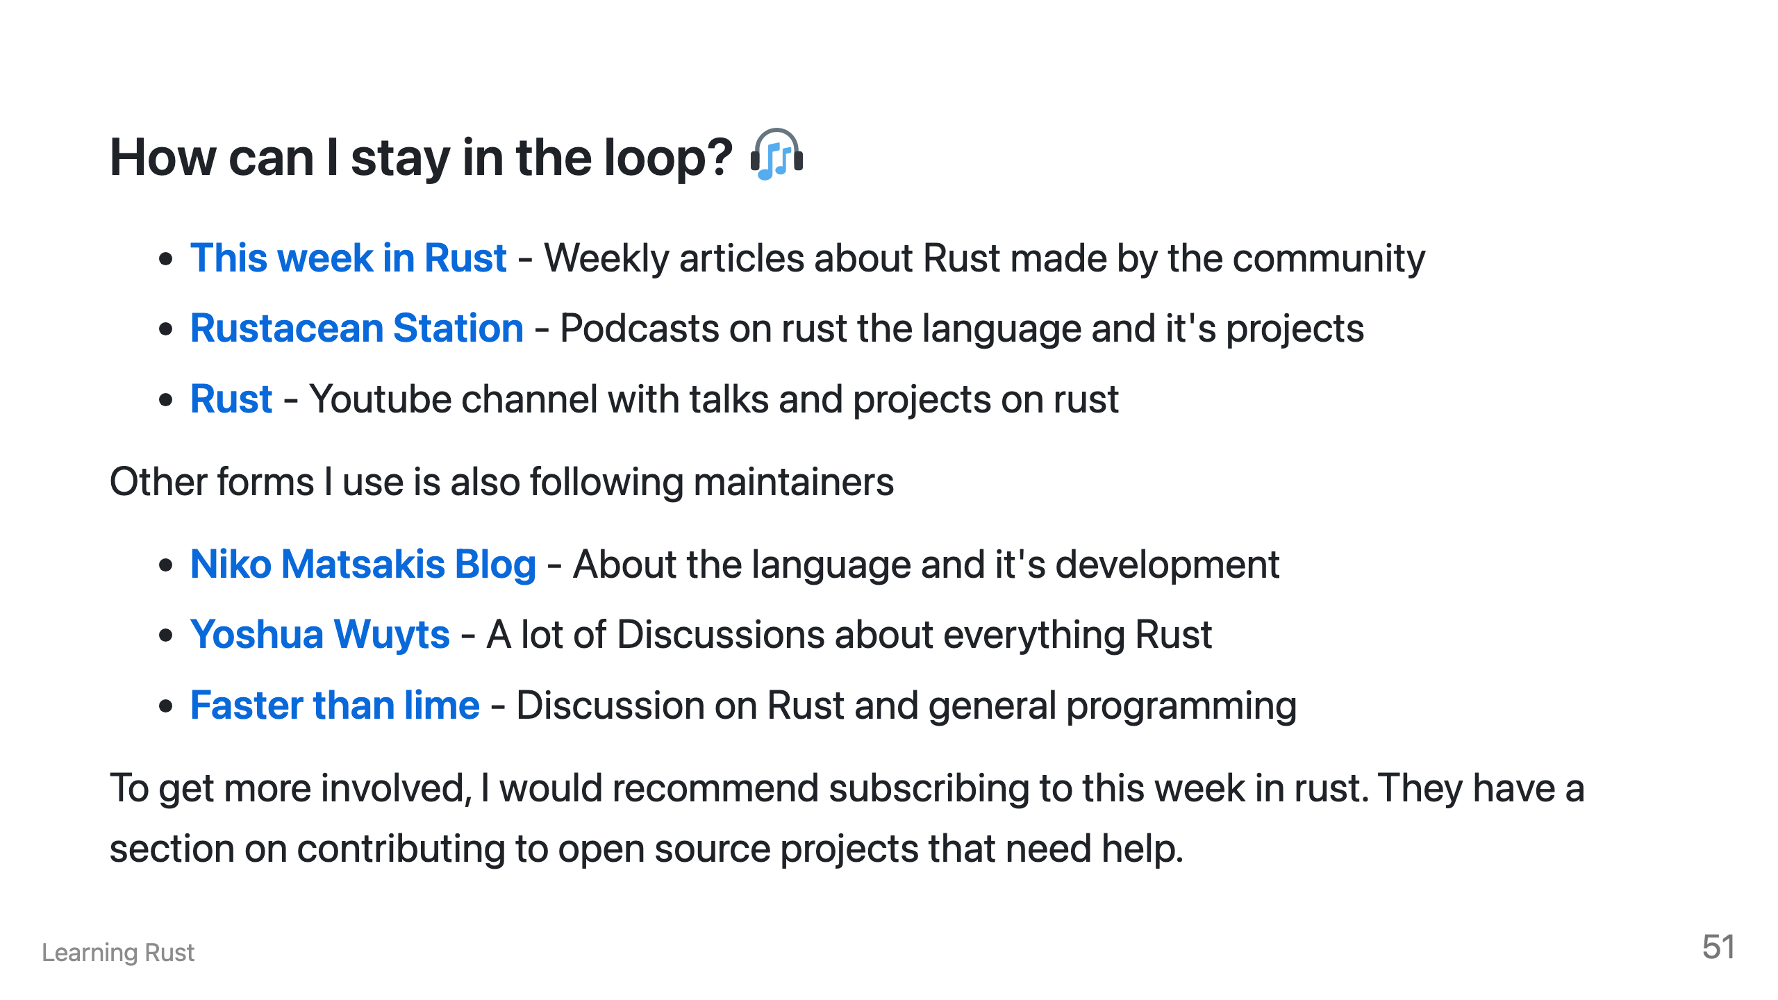

Slide 53


Slide 54


Slide 55

Notes:
https://twitter.com/p1xelHer0/status/1754011970158669855

